Slide 1
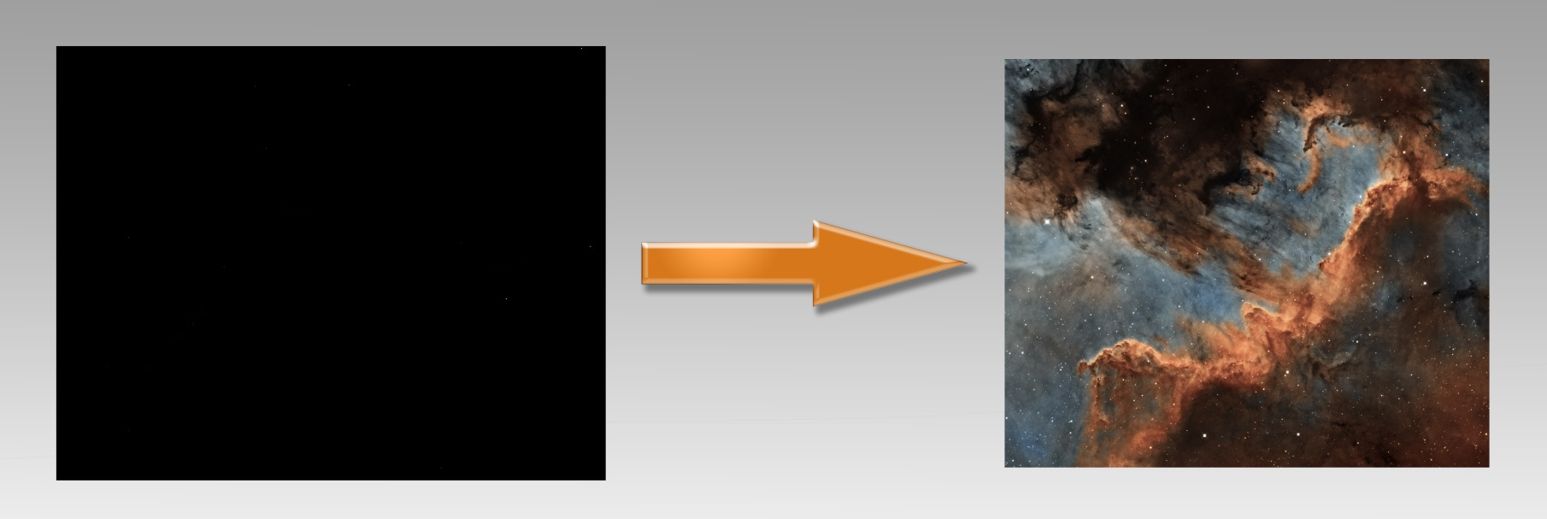
Photoshop processing
Stage by stage

Slide 2
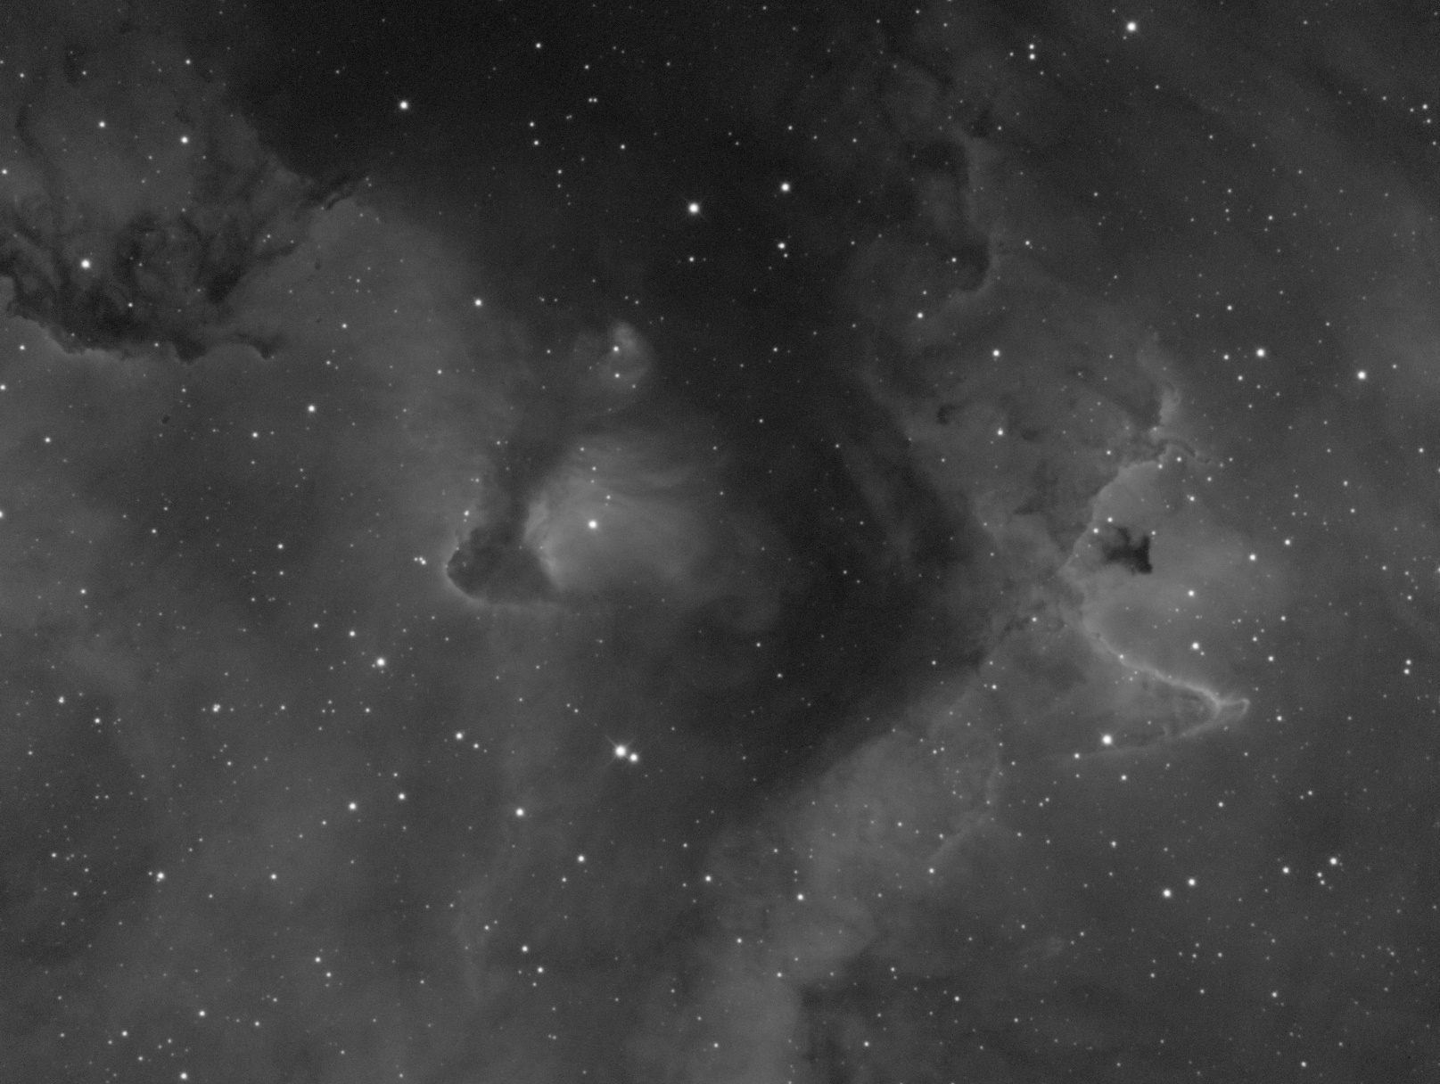
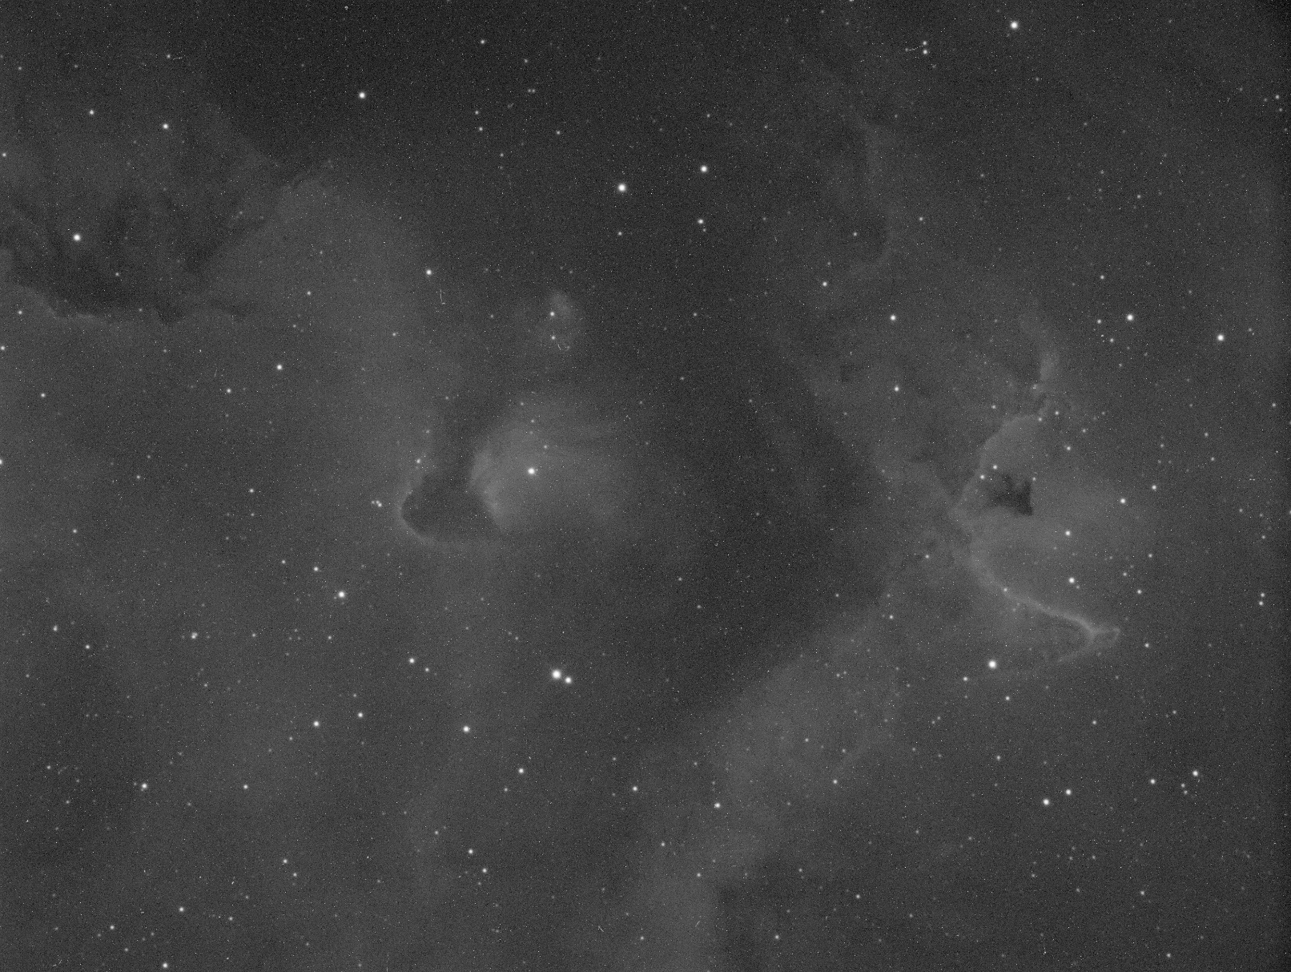
Processing
The benefits of stacking

Slide 3
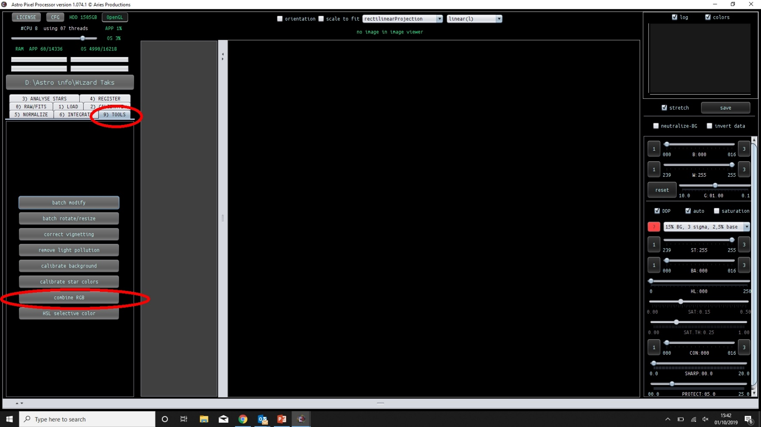
Processing
Merging channels in APP

Slide 4
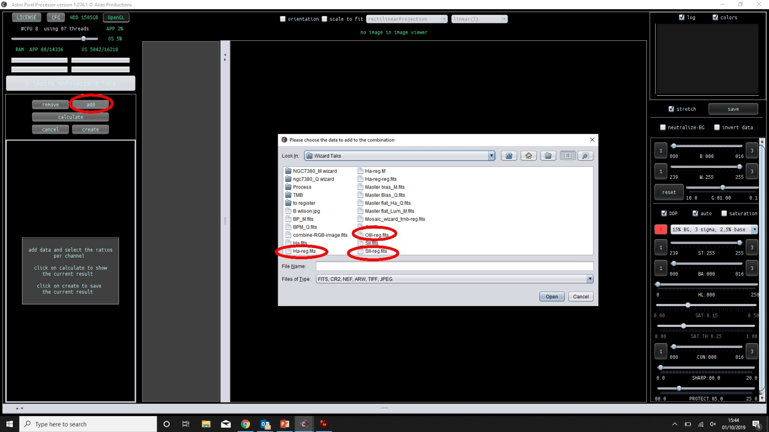
Processing
Add the relevant channels

Slide 5
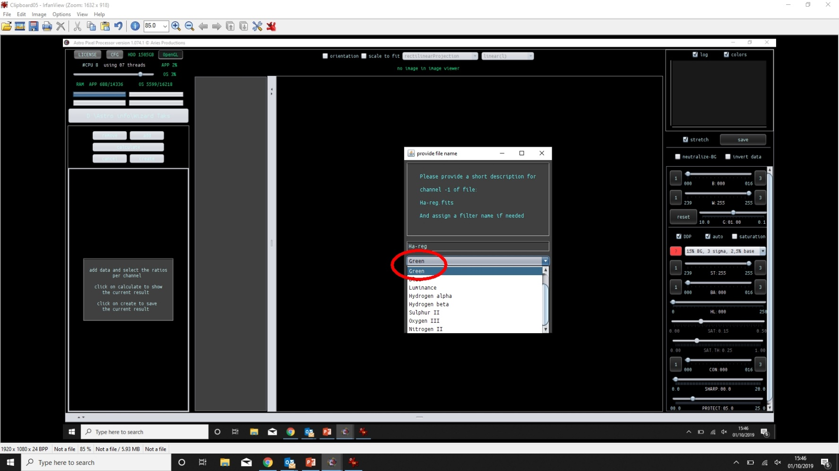
Processing
Allocate the filter to the correct channel

Slide 6
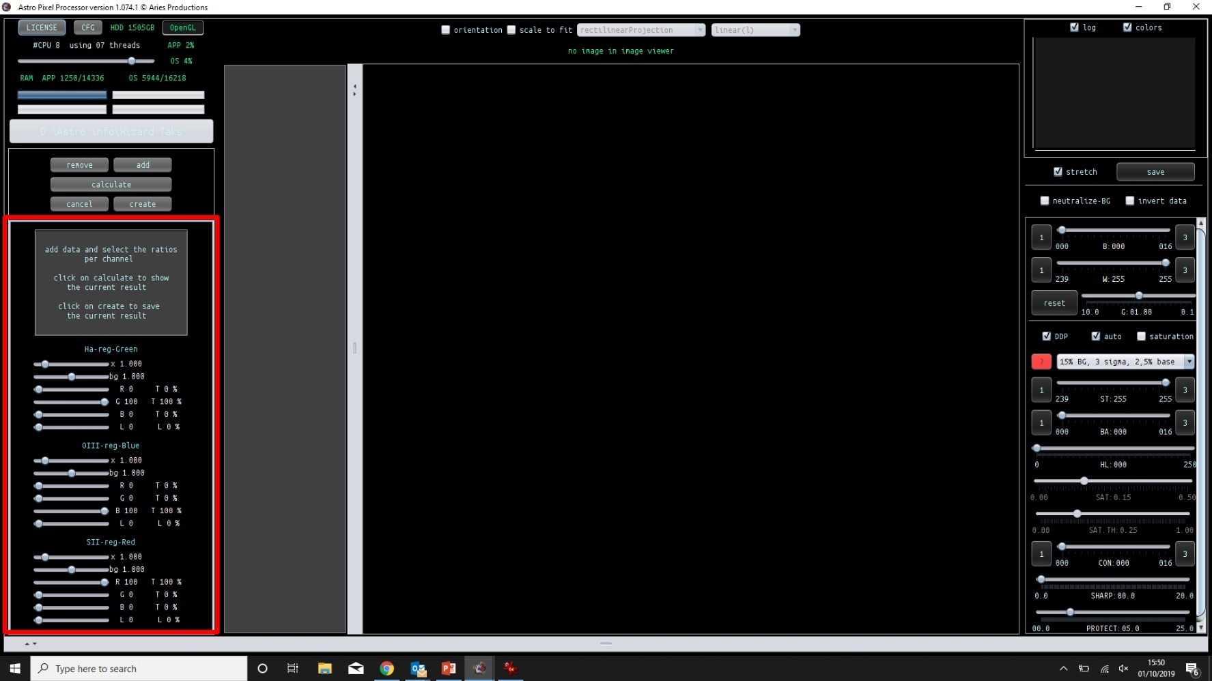
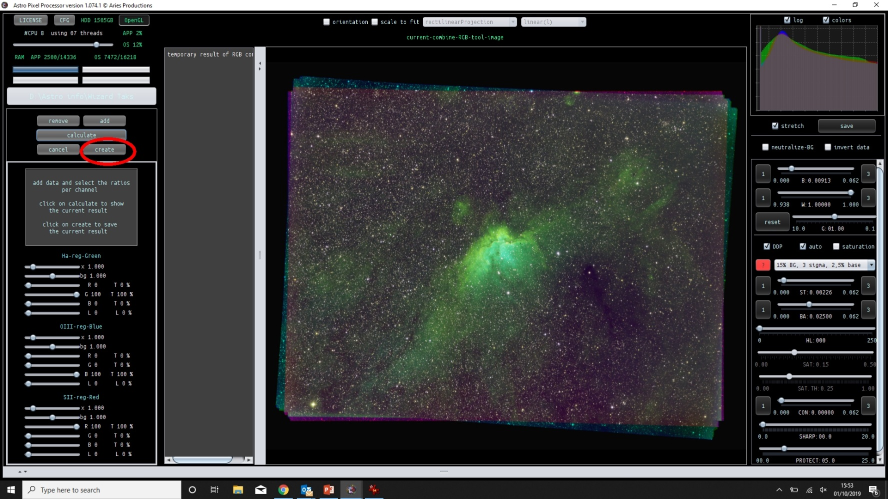
Processing
All filters are in their correct channel

Slide 7
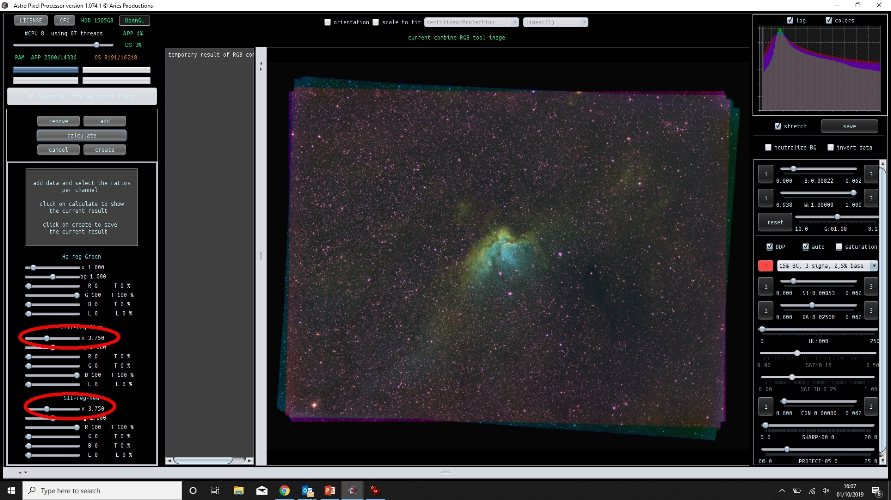
Processing
Change the background strength

Slide 8
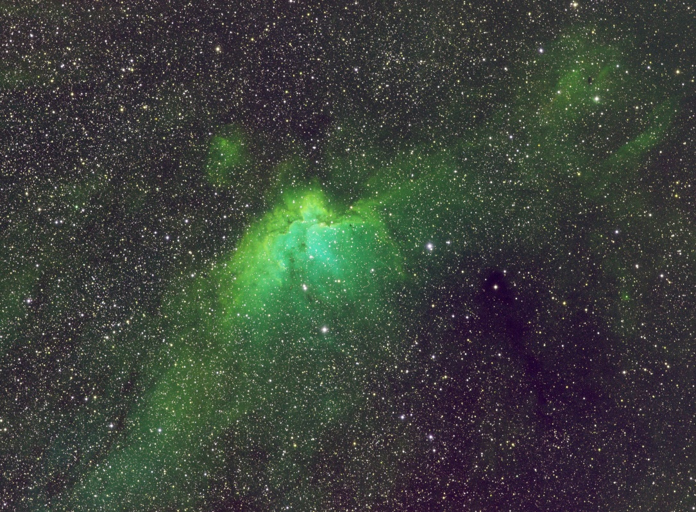
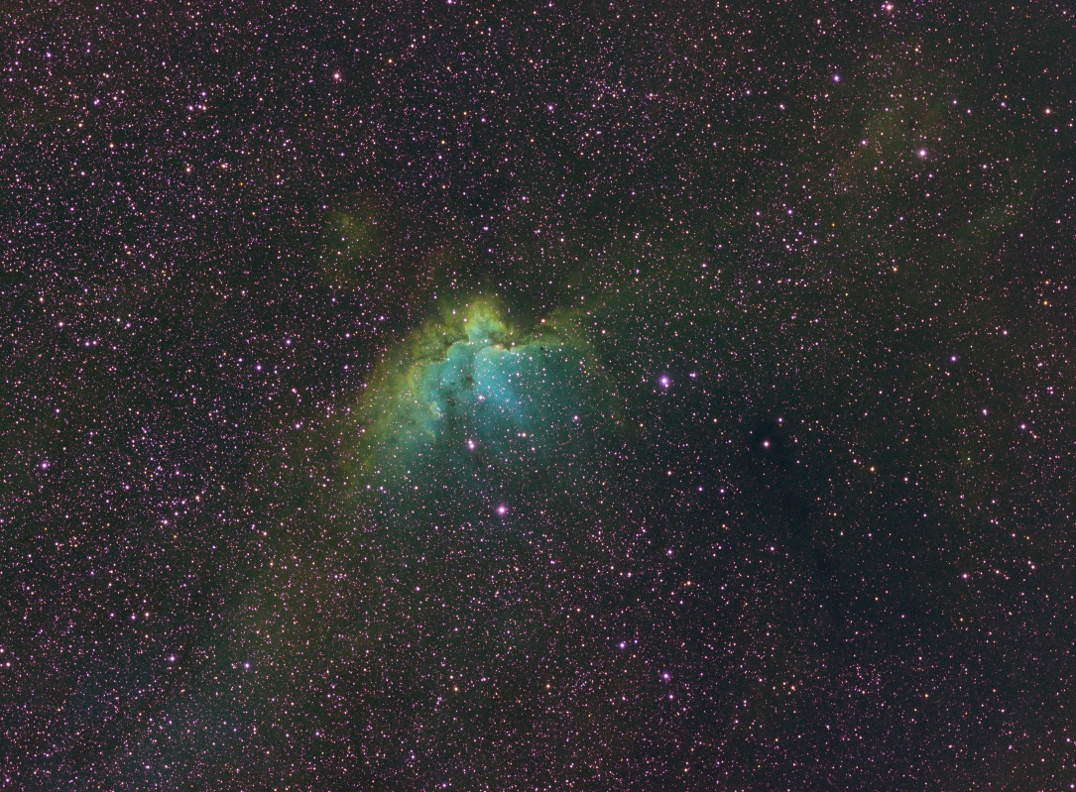
Processing
All channels of equal strength
Background of OIII and SII increased
In relation to Ha

Slide 9
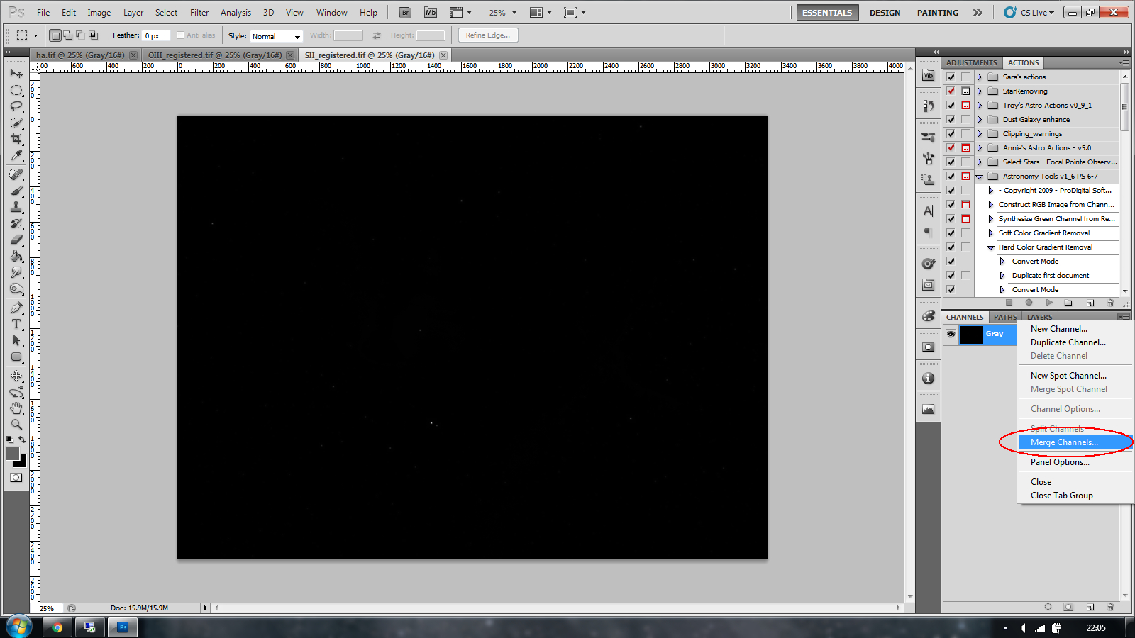
Processing
Merging channels

Slide 10
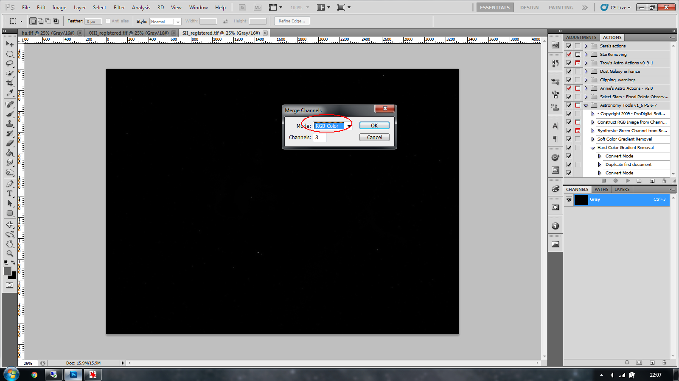
Processing
Merging channels

Slide 11
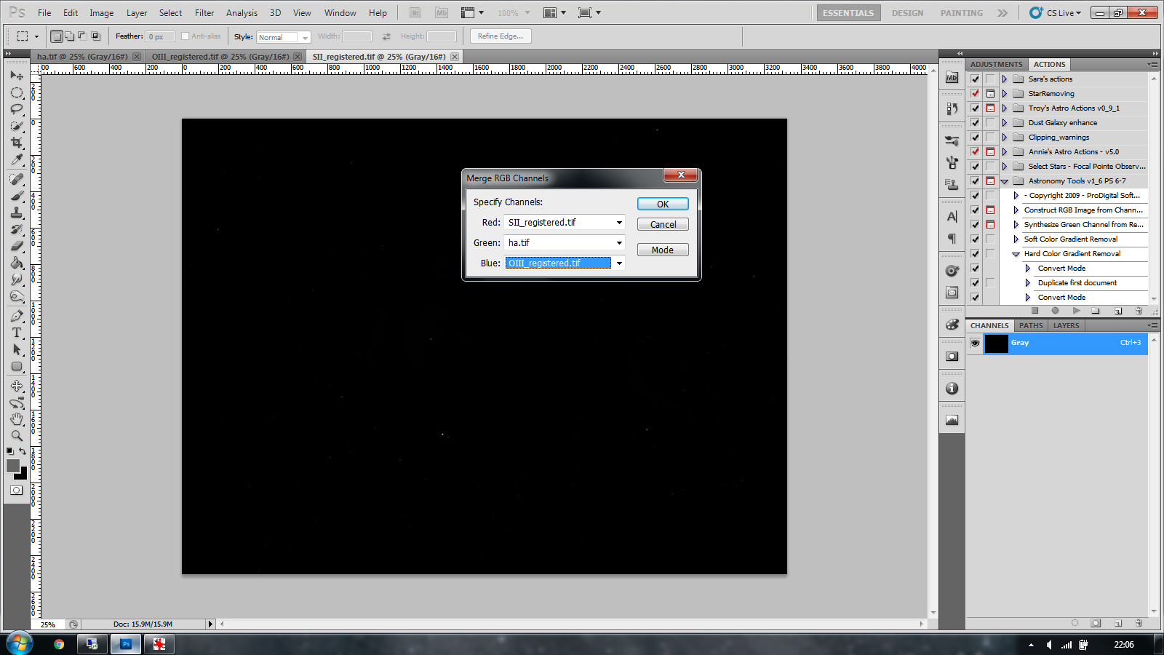
Processing
Merging channels

Slide 12
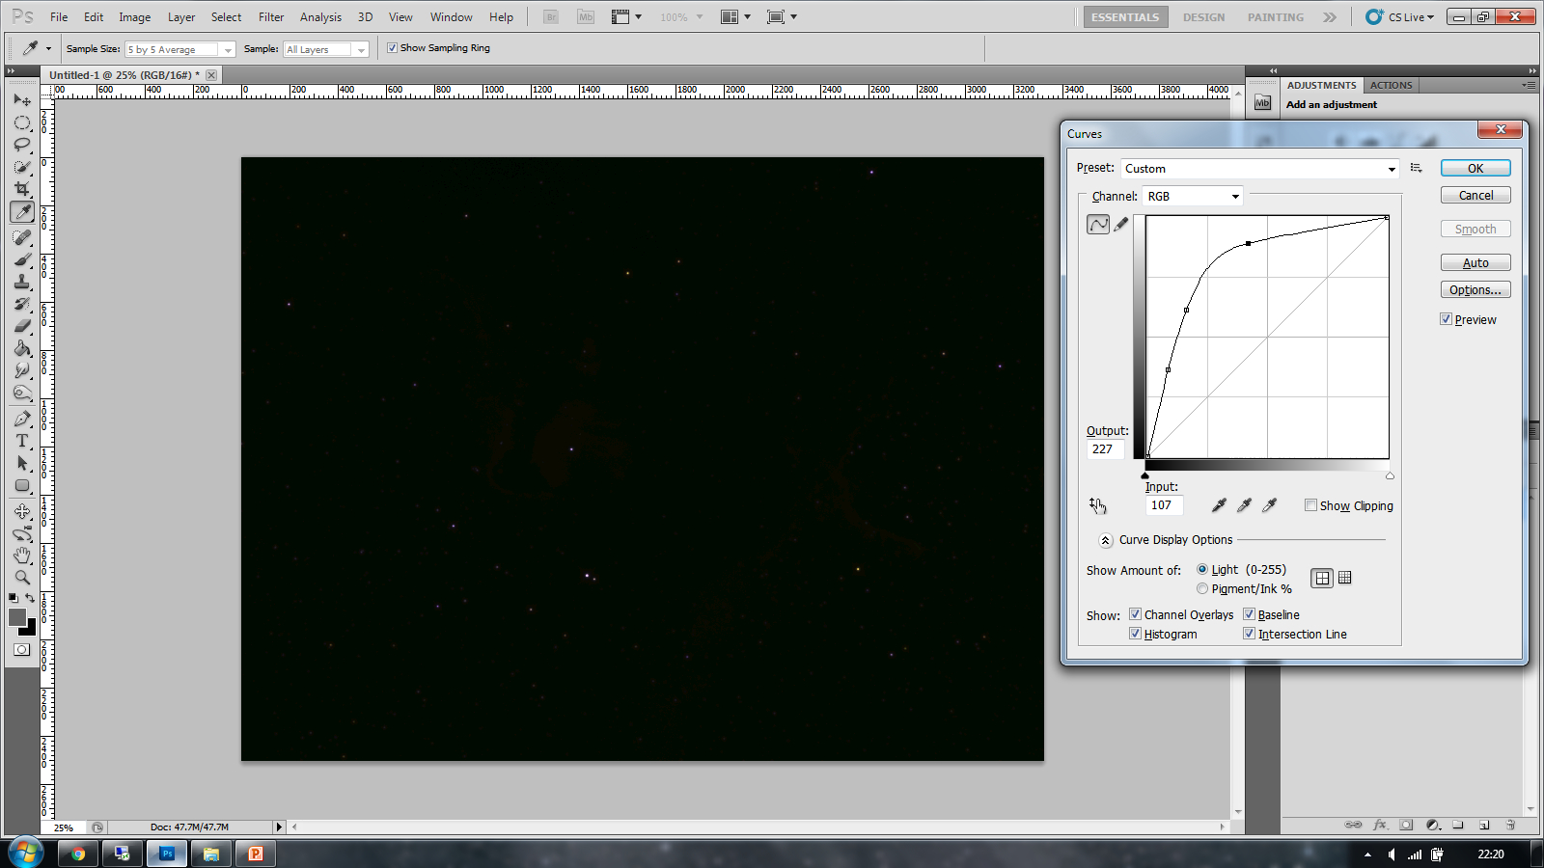
Processing
Curves

Slide 13
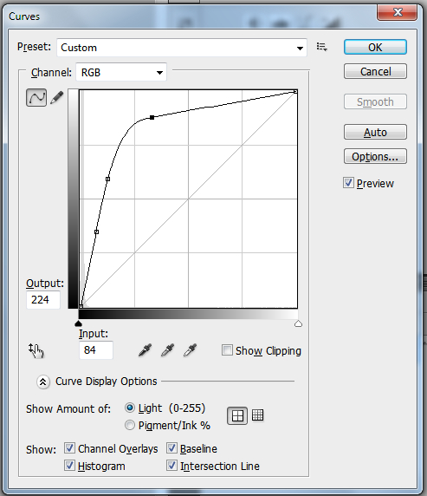
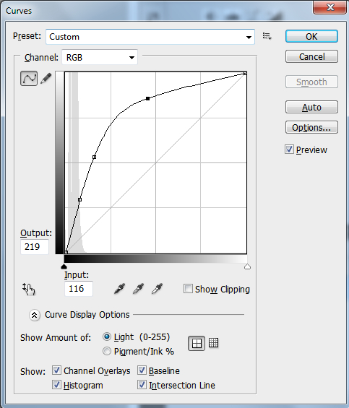
Processing
Curves
Curve 2 Curve 3

Slide 14
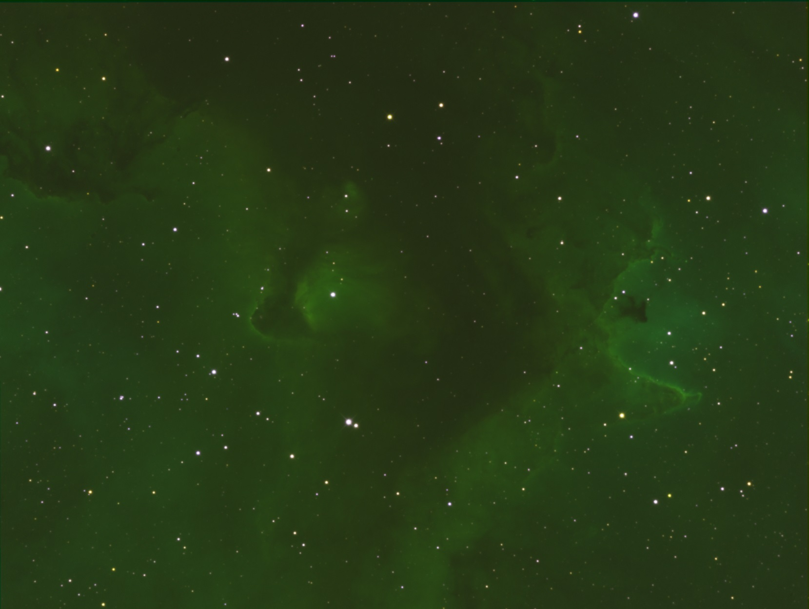
Processing
Curves
Next steps
Levels to balance the colours
Selective Colour tool

Slide 15
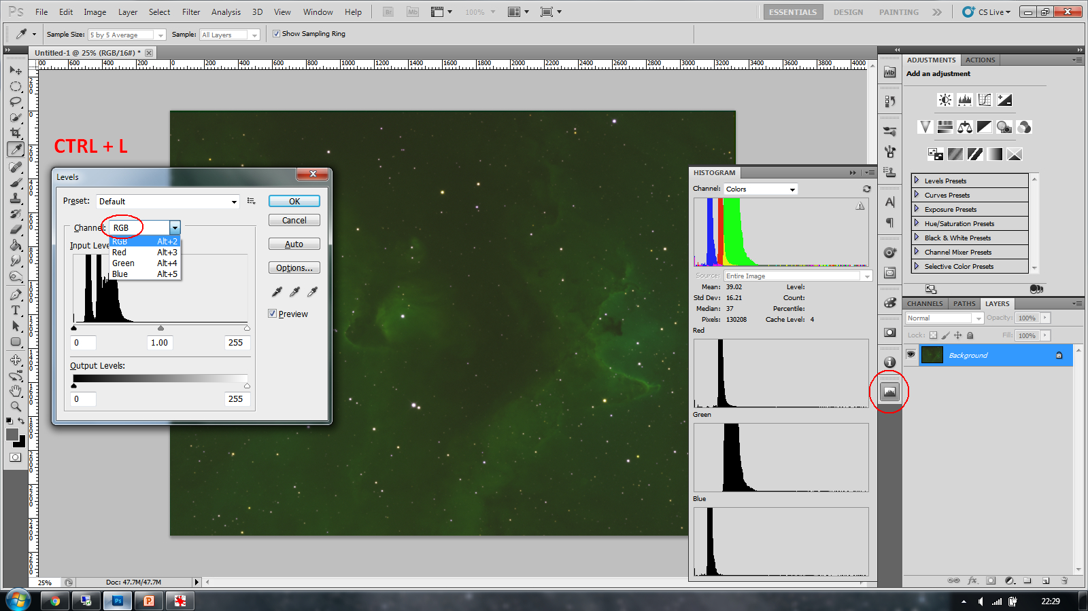
Processing
Levels to balance the colours

Slide 16
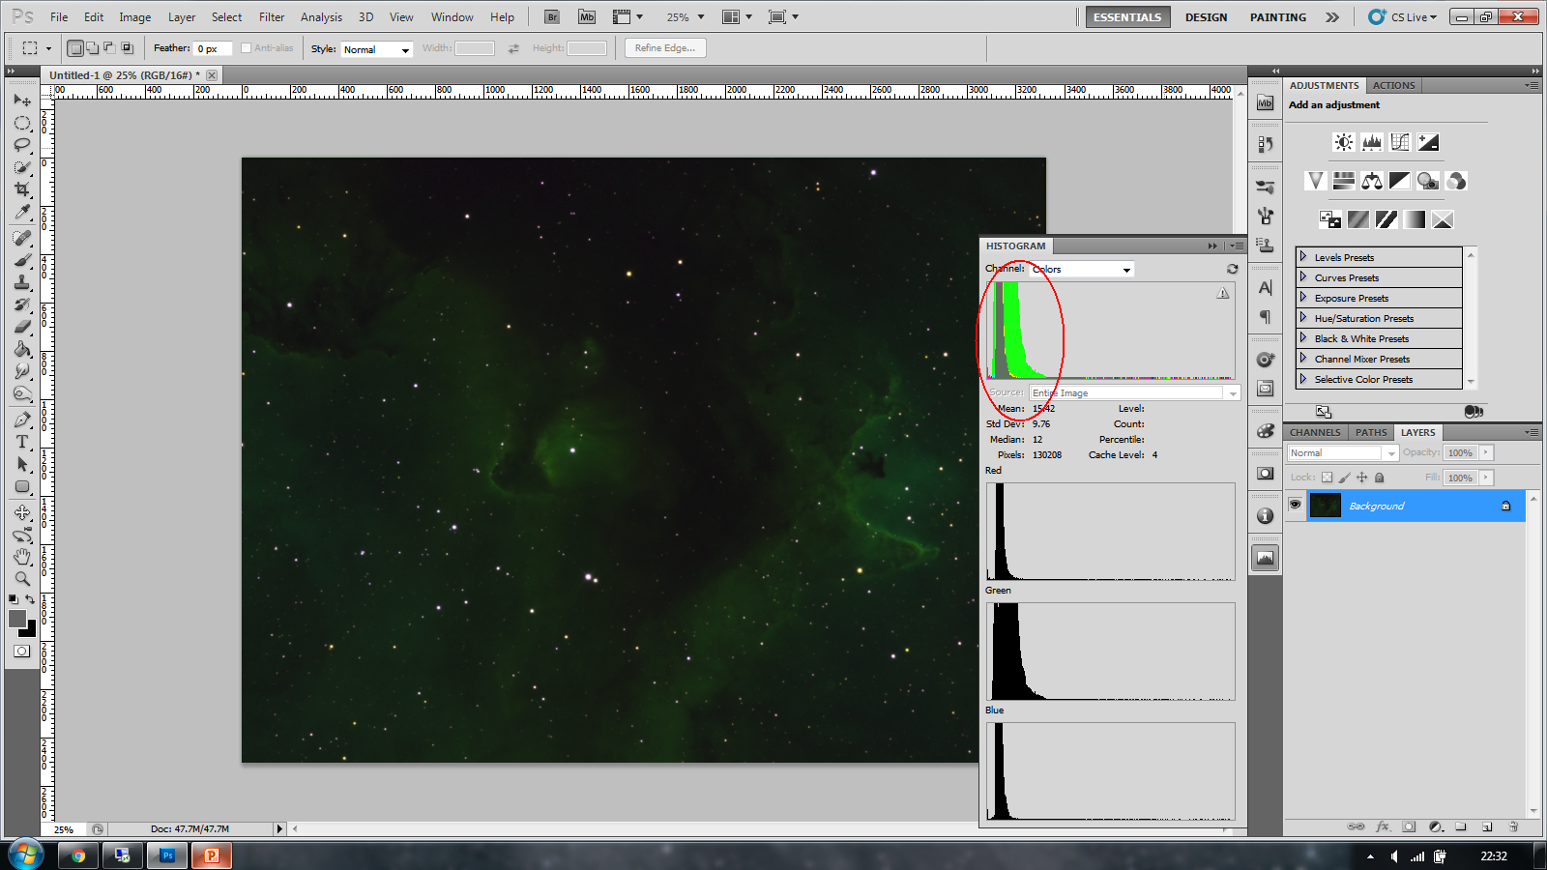
Processing
Levels to balance the colours

Slide 17
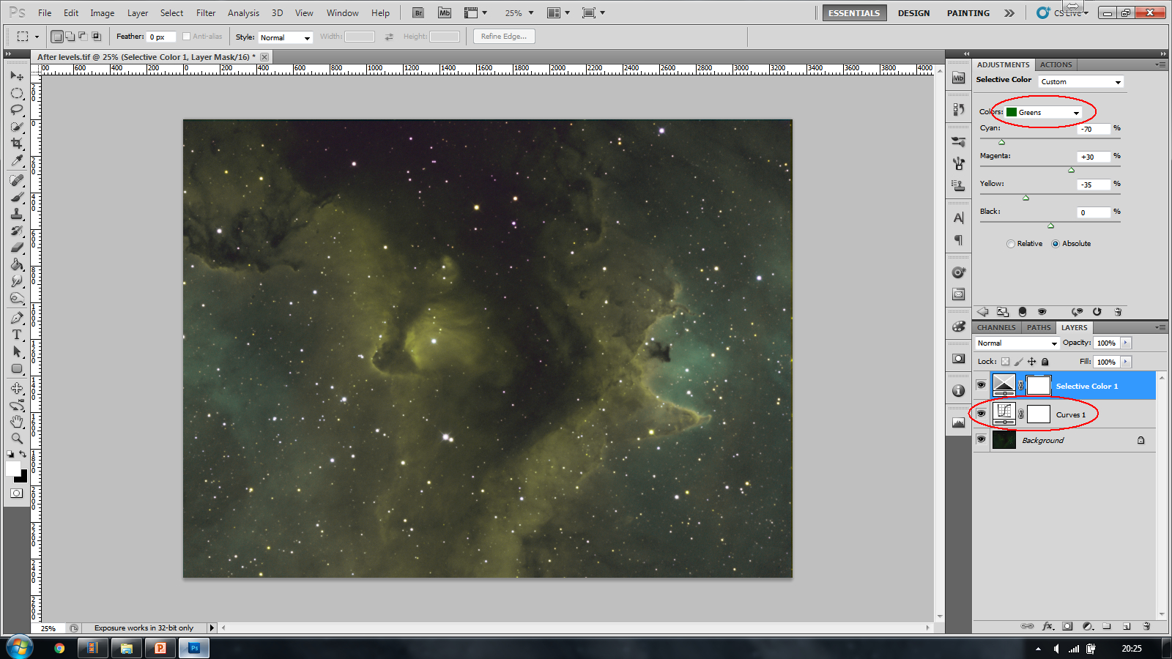
Processing
Curves – A simple curve to see what you are doing
Green Selective colour – First process to change the greens to yellow without destroying the blue
Selective colour (Green)

Slide 18
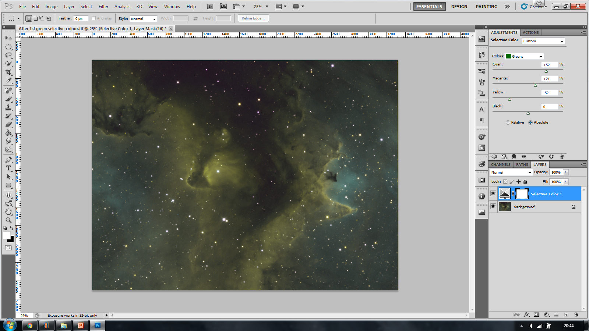
Processing
Green Selective colour – In danger of loosing the blue – Lets consider green again…. Keeping the outer areas blue so that we can work with it later
Selective colour (2nd green)

Slide 19
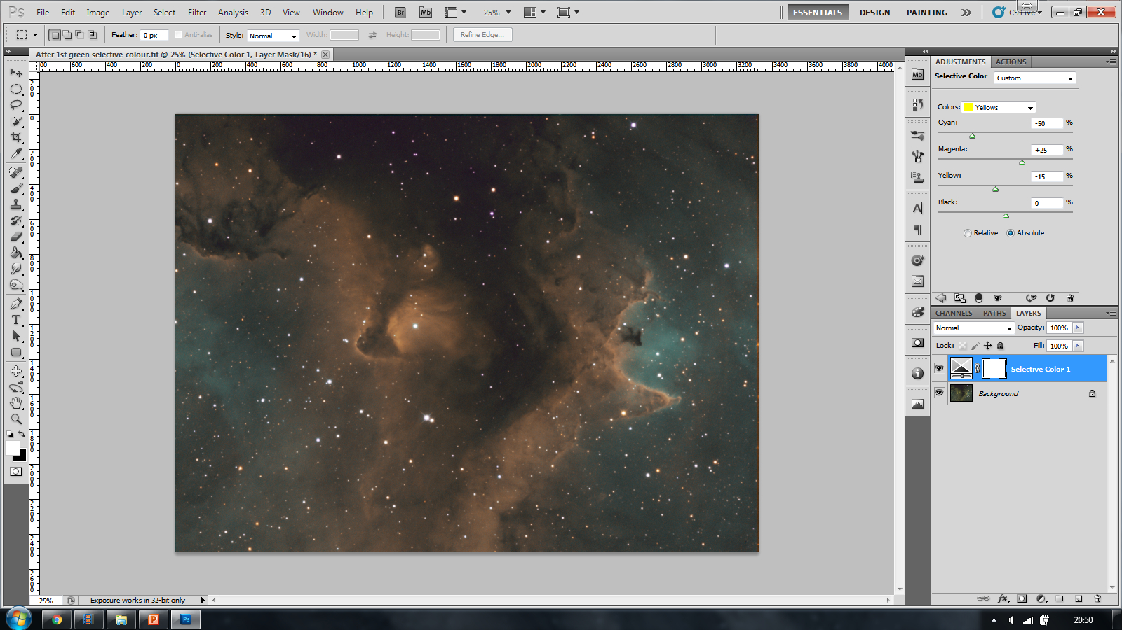
Processing
Yellow Selective colour – Working on making the yellows more orange
Selective colour (yellow)

Slide 20
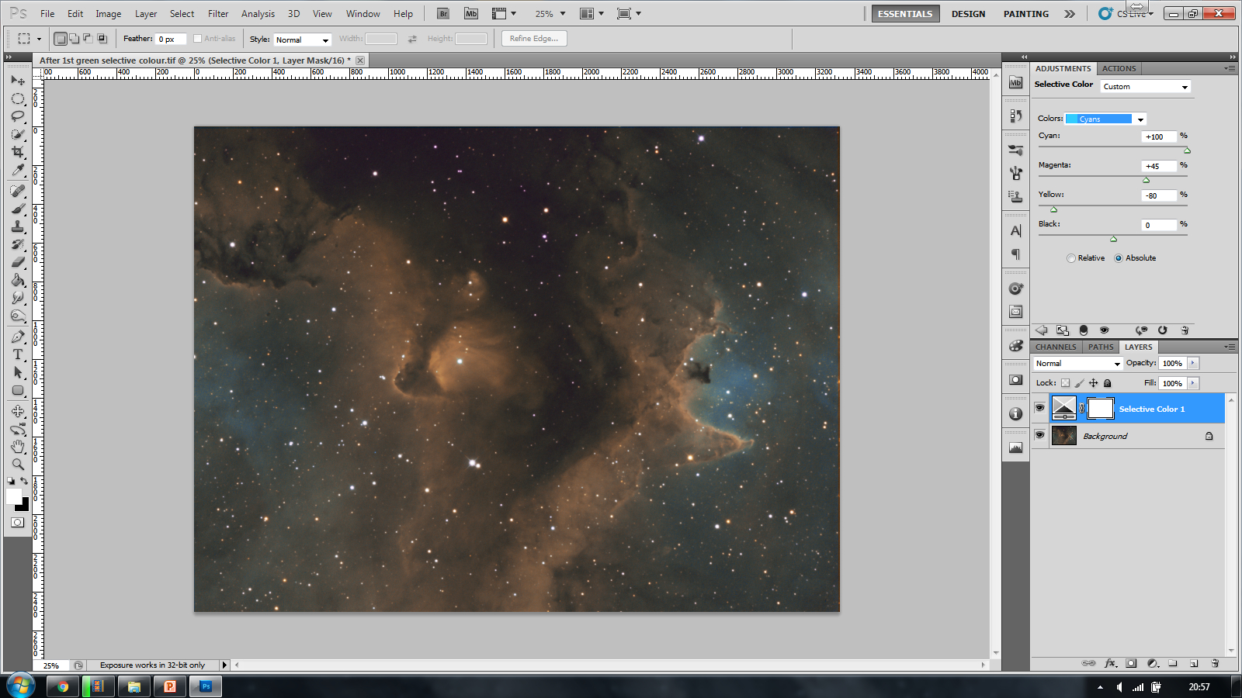
Processing
Cyan Selective colour – Working on the blue areas of the nebula – This can be tweaked further with blue selective colour as required.
Selective colour (cyan)

Slide 21
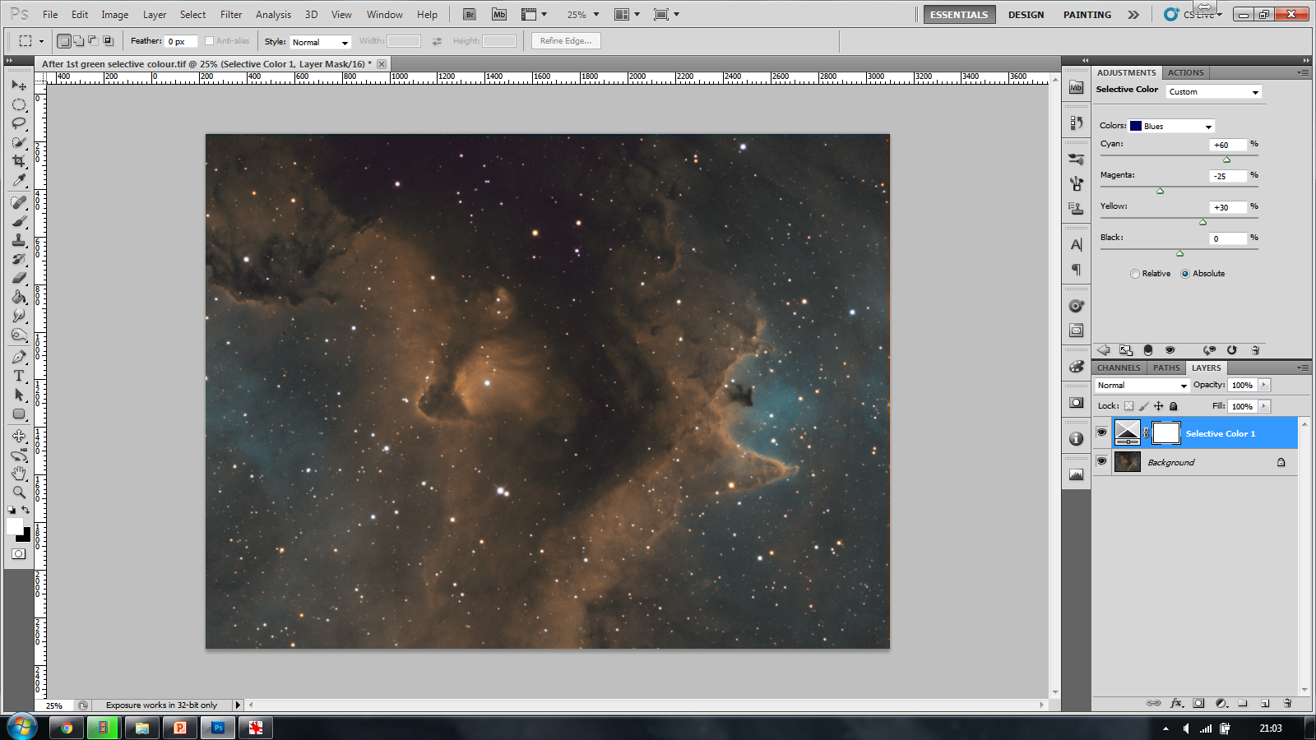
Processing
Blue Selective colour – Changing the blue to a lighter and slightly more cyan colour….
Selective colour (blue)

Slide 22
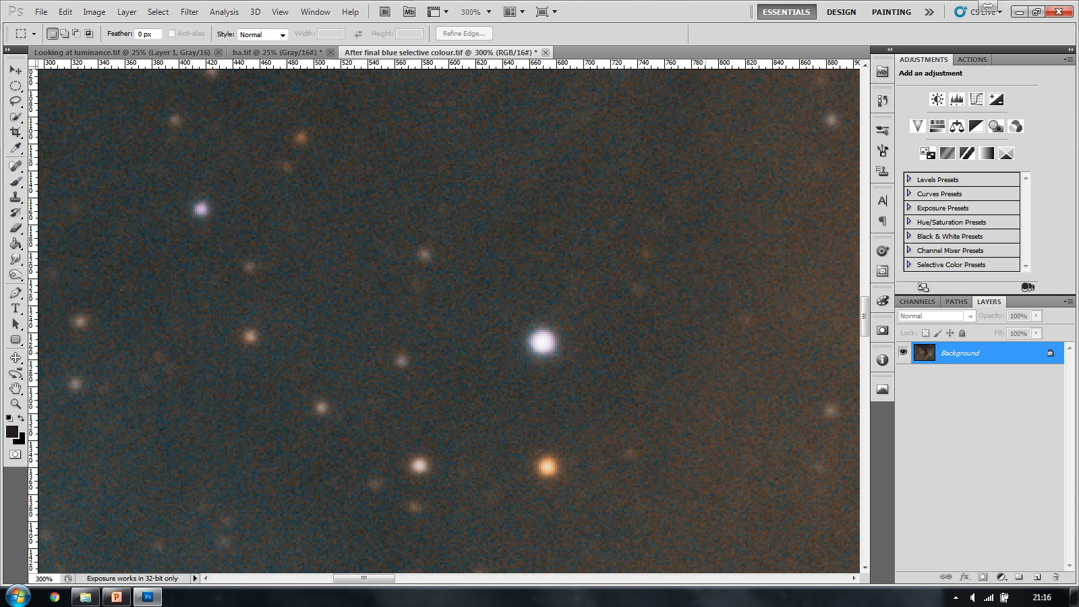
Processing
Preparing for luminance (noise)

Slide 23
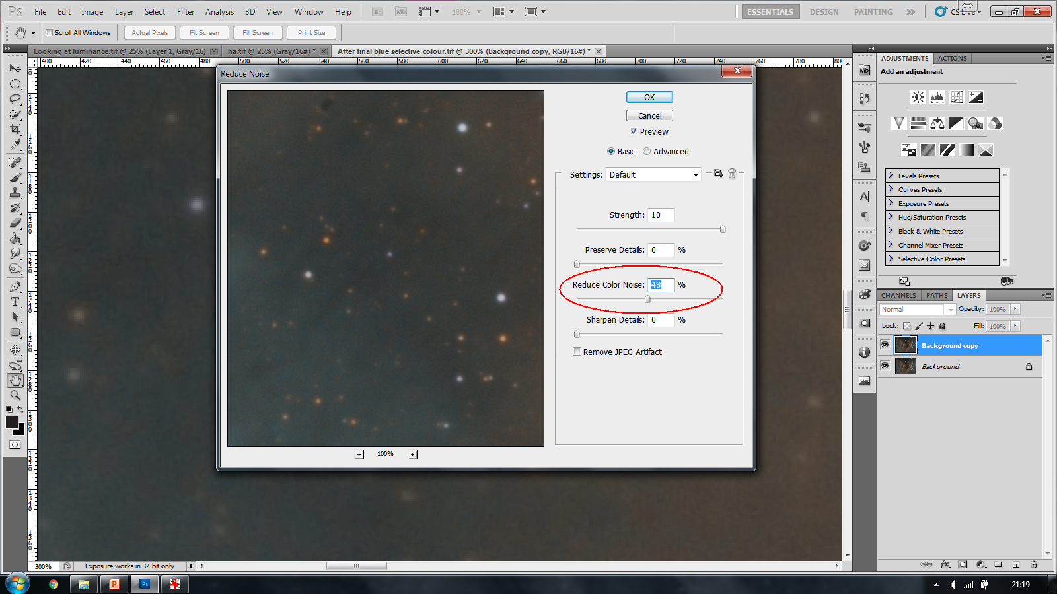
Processing
Blurring the layer to combat noise

Slide 24
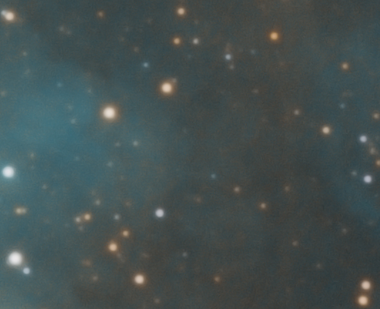
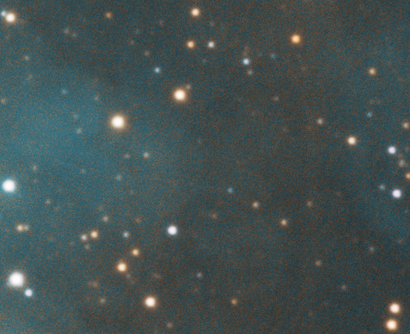
Processing
The difference once noise is removed

Slide 25


Processing
Considering the luminance
False Luminance
Luminance
Ha as luminance
How to create a false luminance
Use the image BEFORE any noise reduction
Desaturate the image by changing the mode to grayscale
Why a false luminance
It will include the details from ALL data channels. In some cases this is imperative
Using a luminance filter you will get data in all visible channels.
Star bloat issues
Light pollution
Data is only in the Ha channel – Lets consider if this is an issue.
Stars are smaller

Slide 26
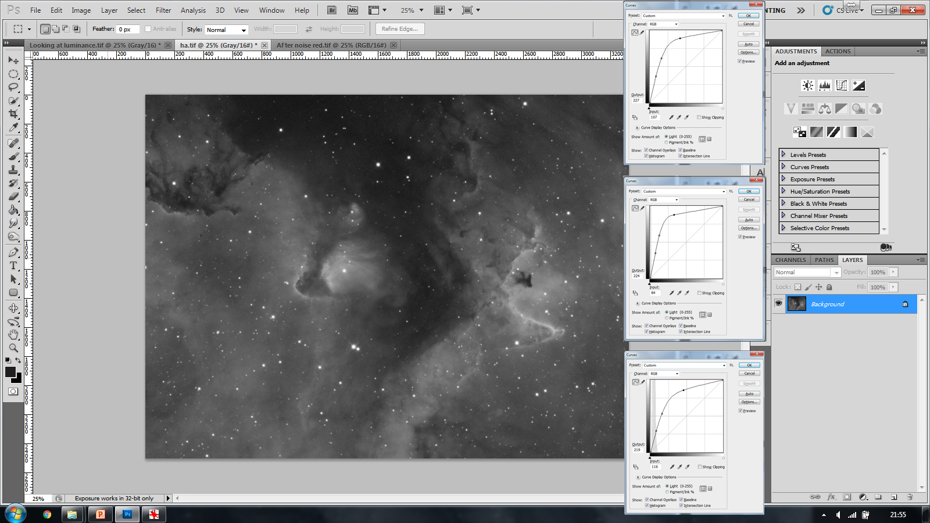
Processing
Creating an Ha luminance

Slide 27
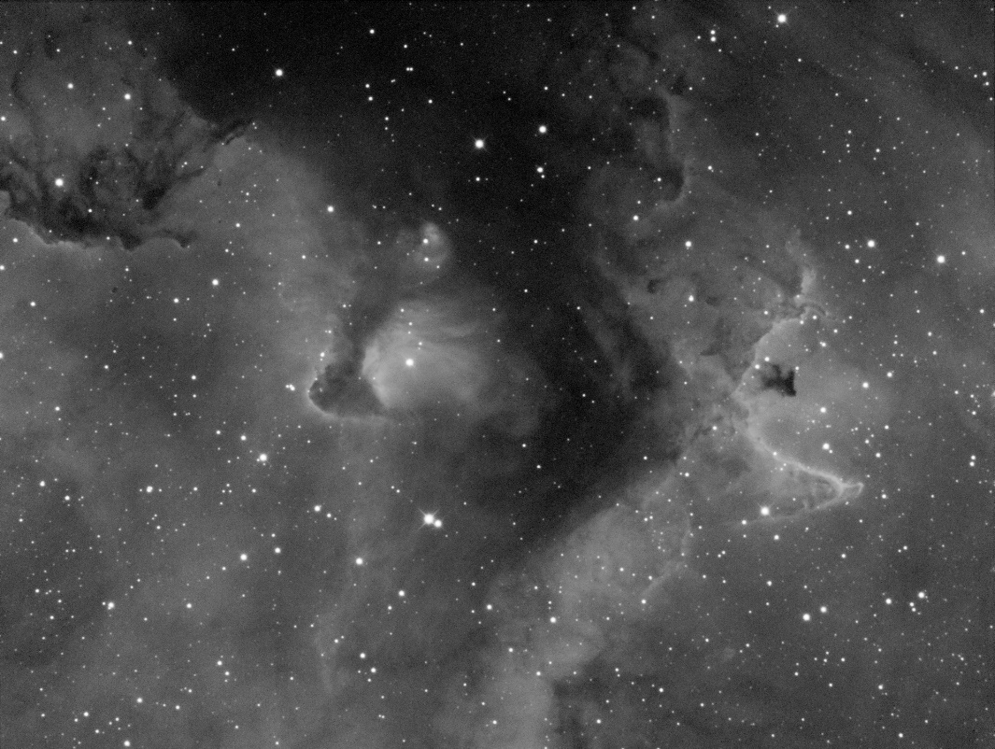
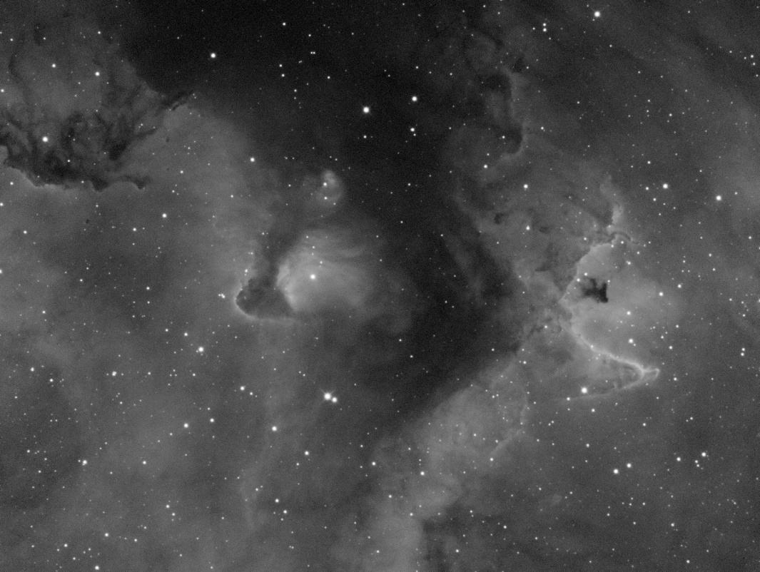
Processing
Comparing the luminance
False luminance Ha only luminance
Very little difference between them.
False luminance has a little more noise
Ha luminance has smaller stars

Slide 28
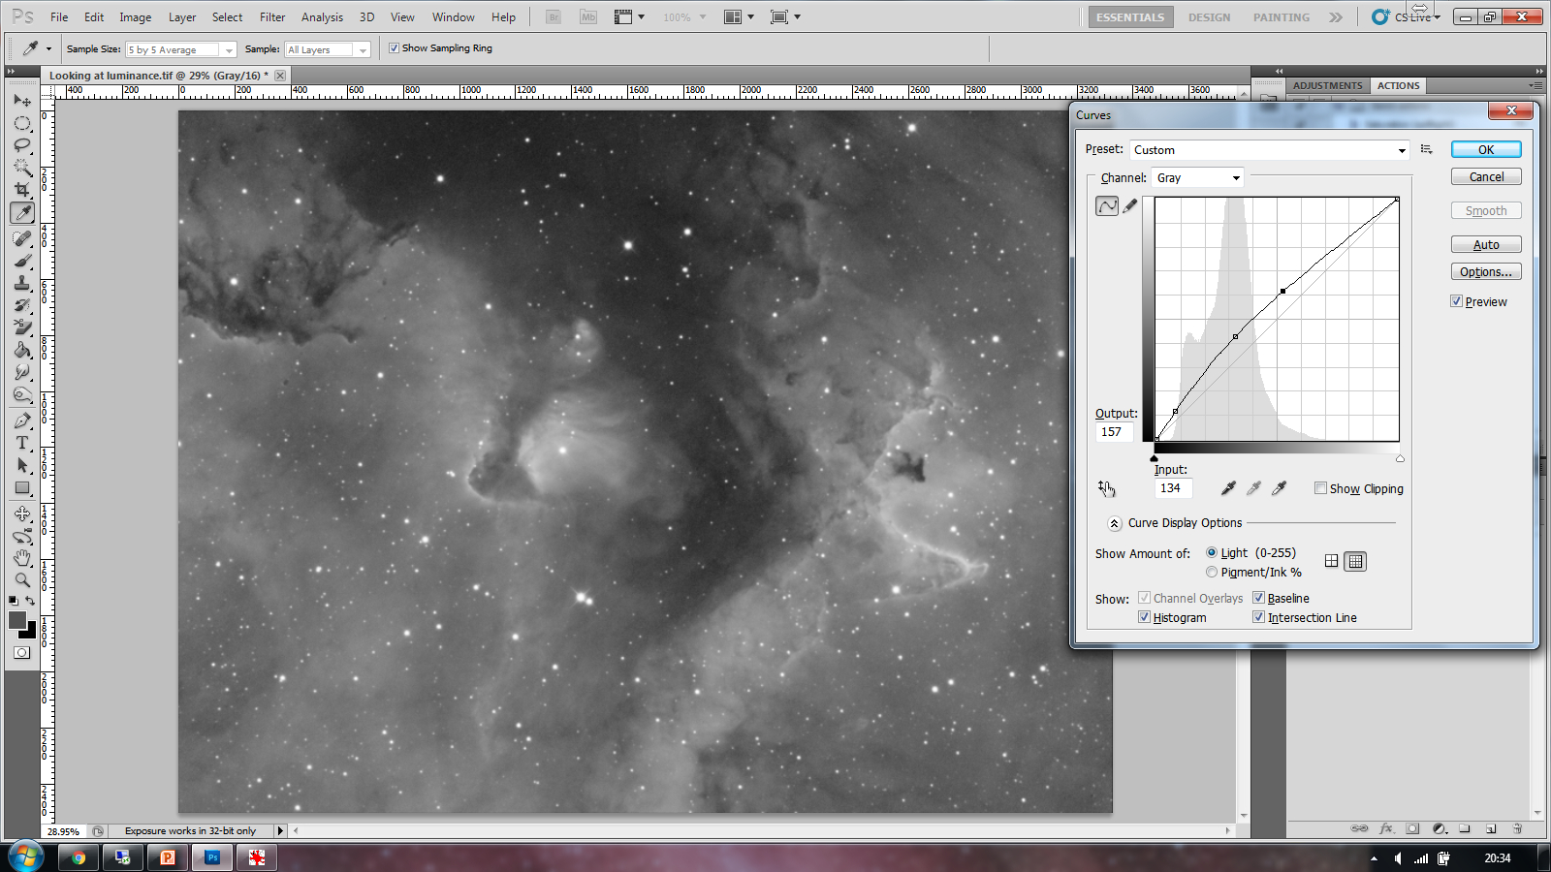
Processing
Curves – Lighten the Luminance
Ensure that there is no clipping of the dark areas
Luminance

Slide 29
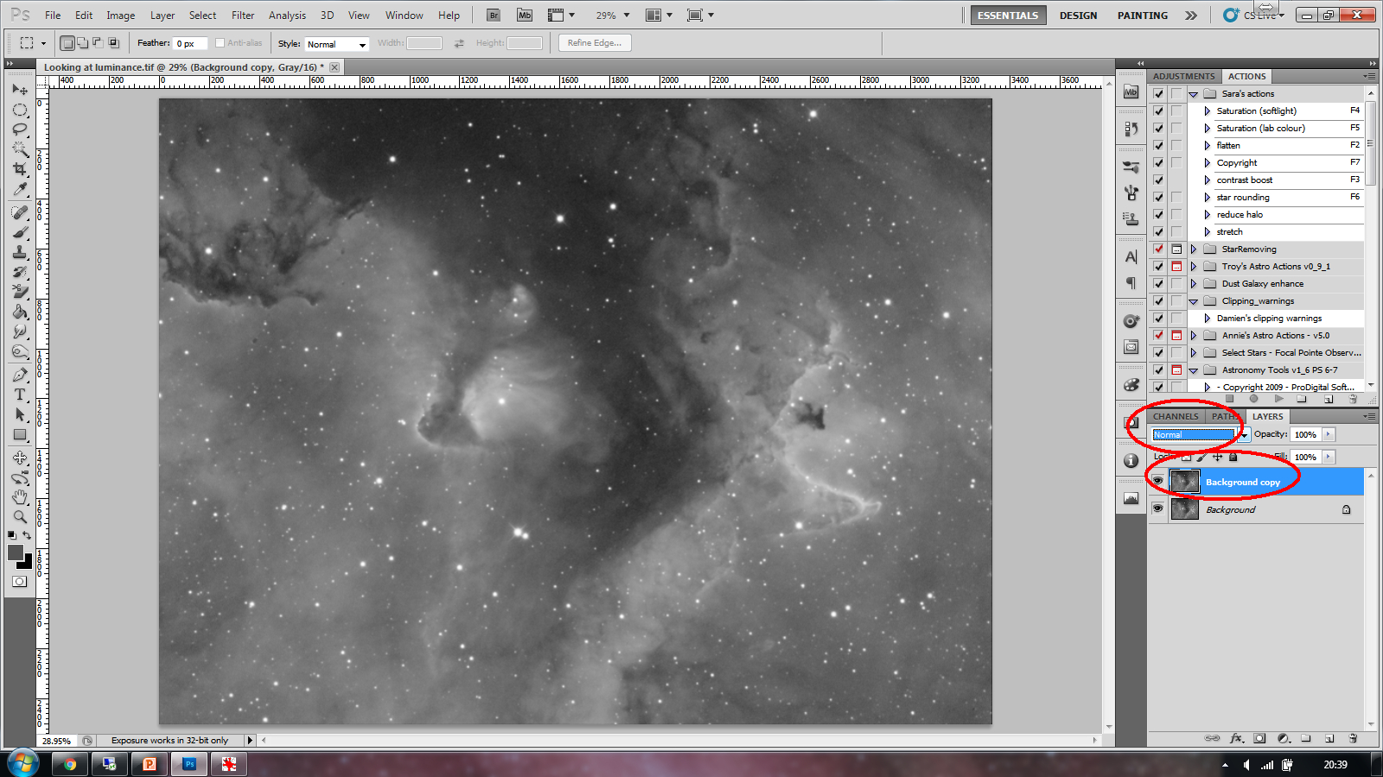
Processing
Duplicate the layer
Select ‘Blend mode’ overlay
Sharpen the luminance

Slide 30
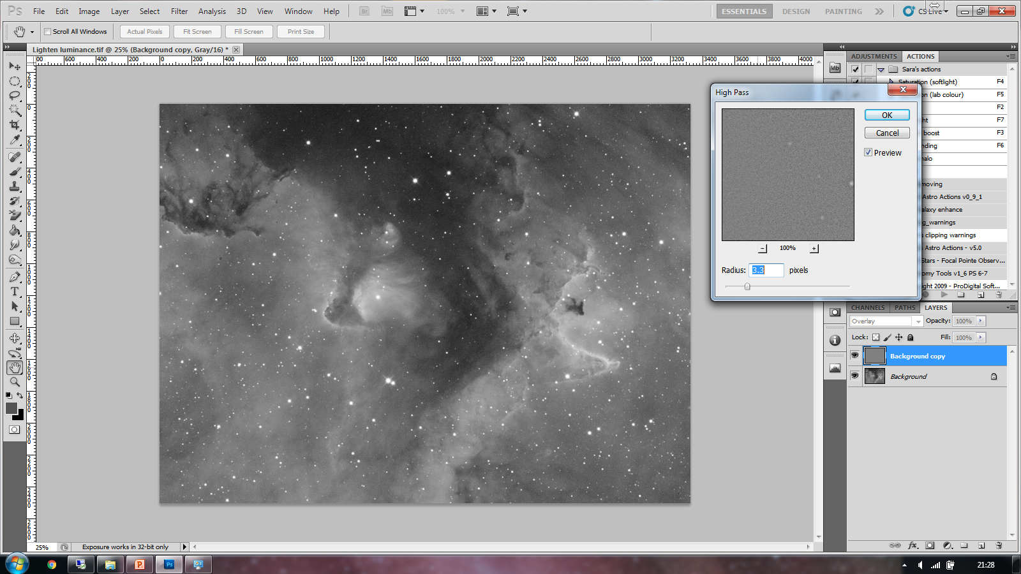
Processing
High Pass – Radius selection…
This can be tweaked in Opacity afterwards in a couple of ways
Sharpen the luminance – High Pass

Slide 31
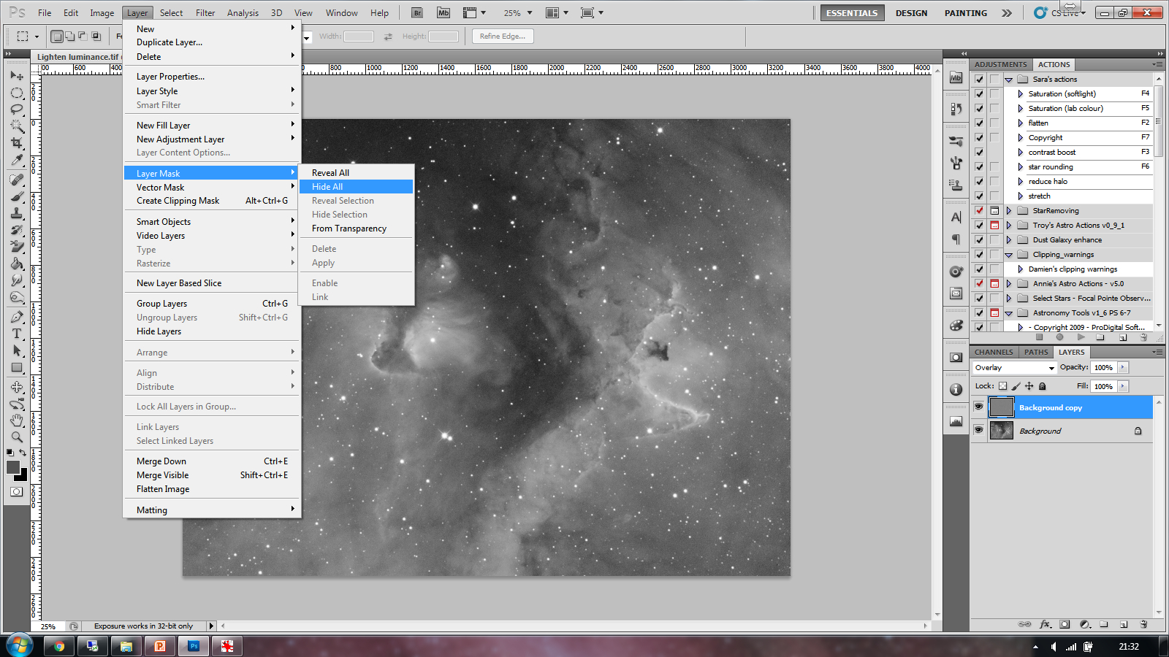
Processing
Layer mask – Hide
This allows us to sharpen up edge details and where the signal is the best
Sharpen the luminance – High Pass

Slide 32
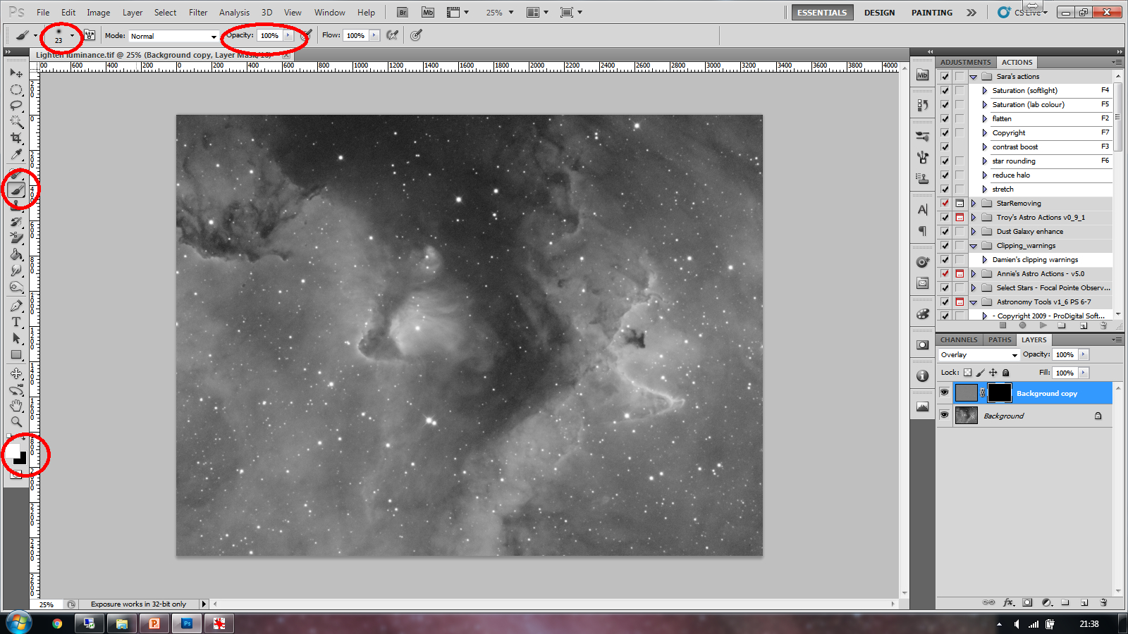
Processing
Background selection
Select brush
Select brush size
Select Opacity
Sharpen the luminance – High Pass

Slide 33
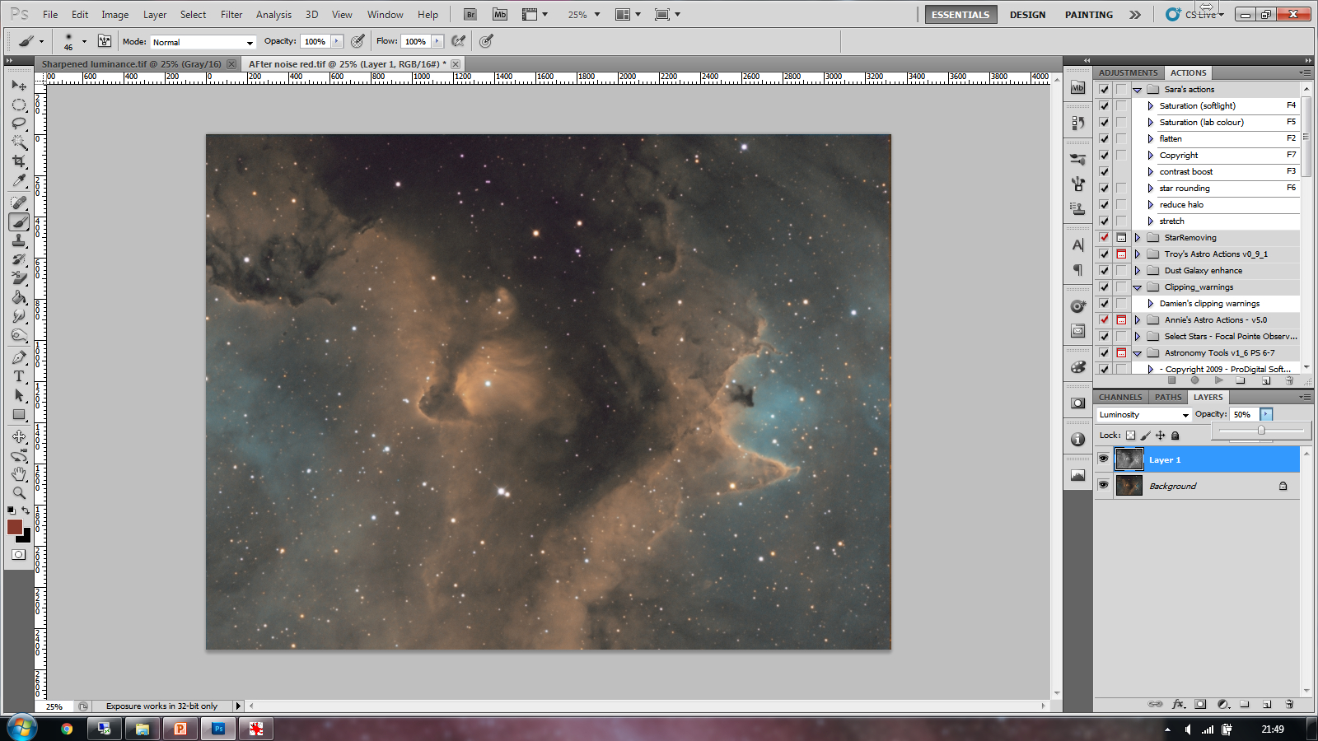
Processing
Copy the Luminance image and paste it onto the Coloured Noise reduced image.
Don’t add all luminance at once
Using the Luminance

Slide 34
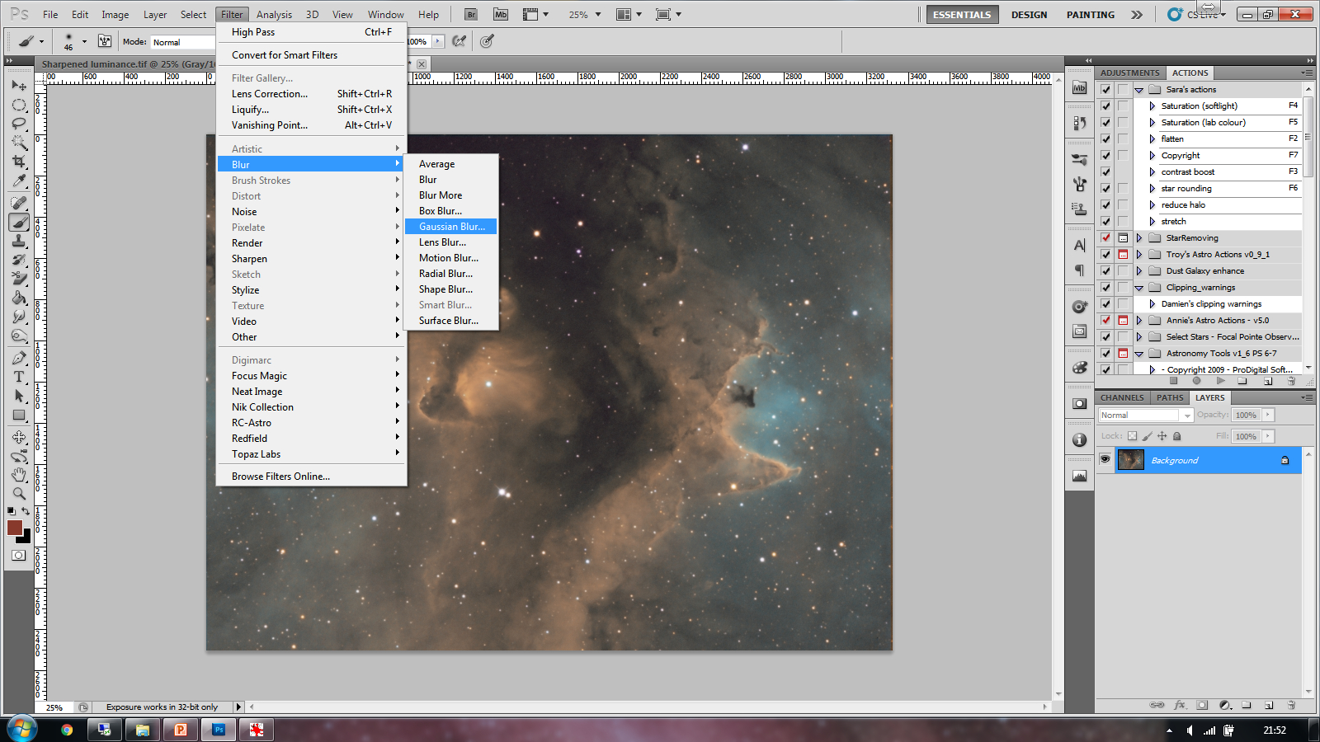
Processing
Iteratively add the luminance and blur in-between each iteration of about 0.9 pixels
Using the Luminance

Slide 35
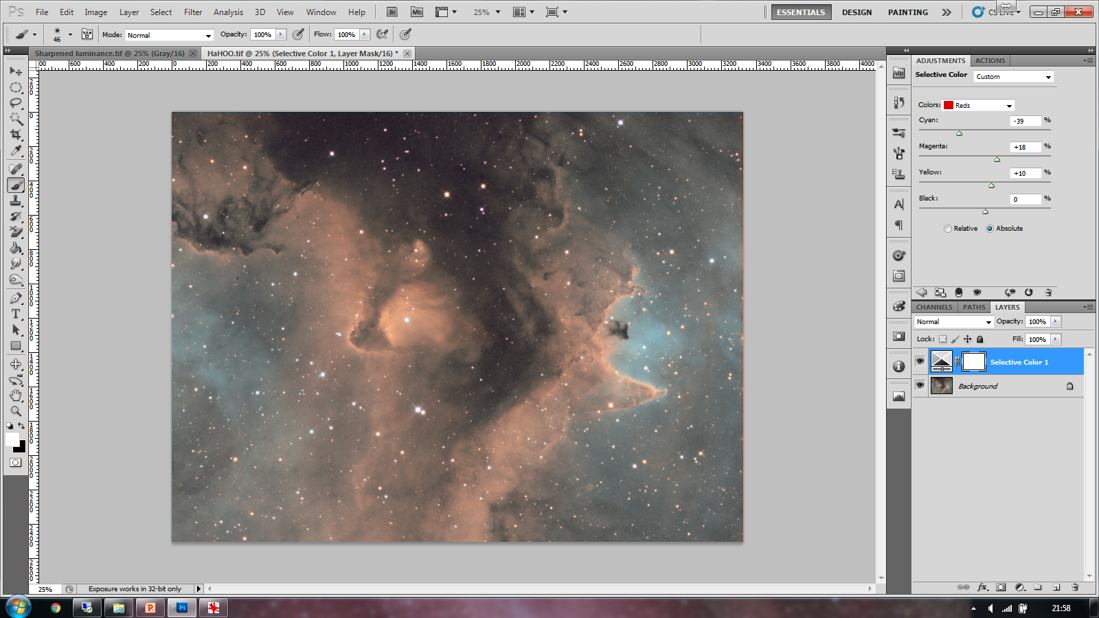
Processing
Once the luminance has been added to 100% opacity – Consider the colour again.
Red / Blue / Cyan
Tweaking the colour

Slide 36
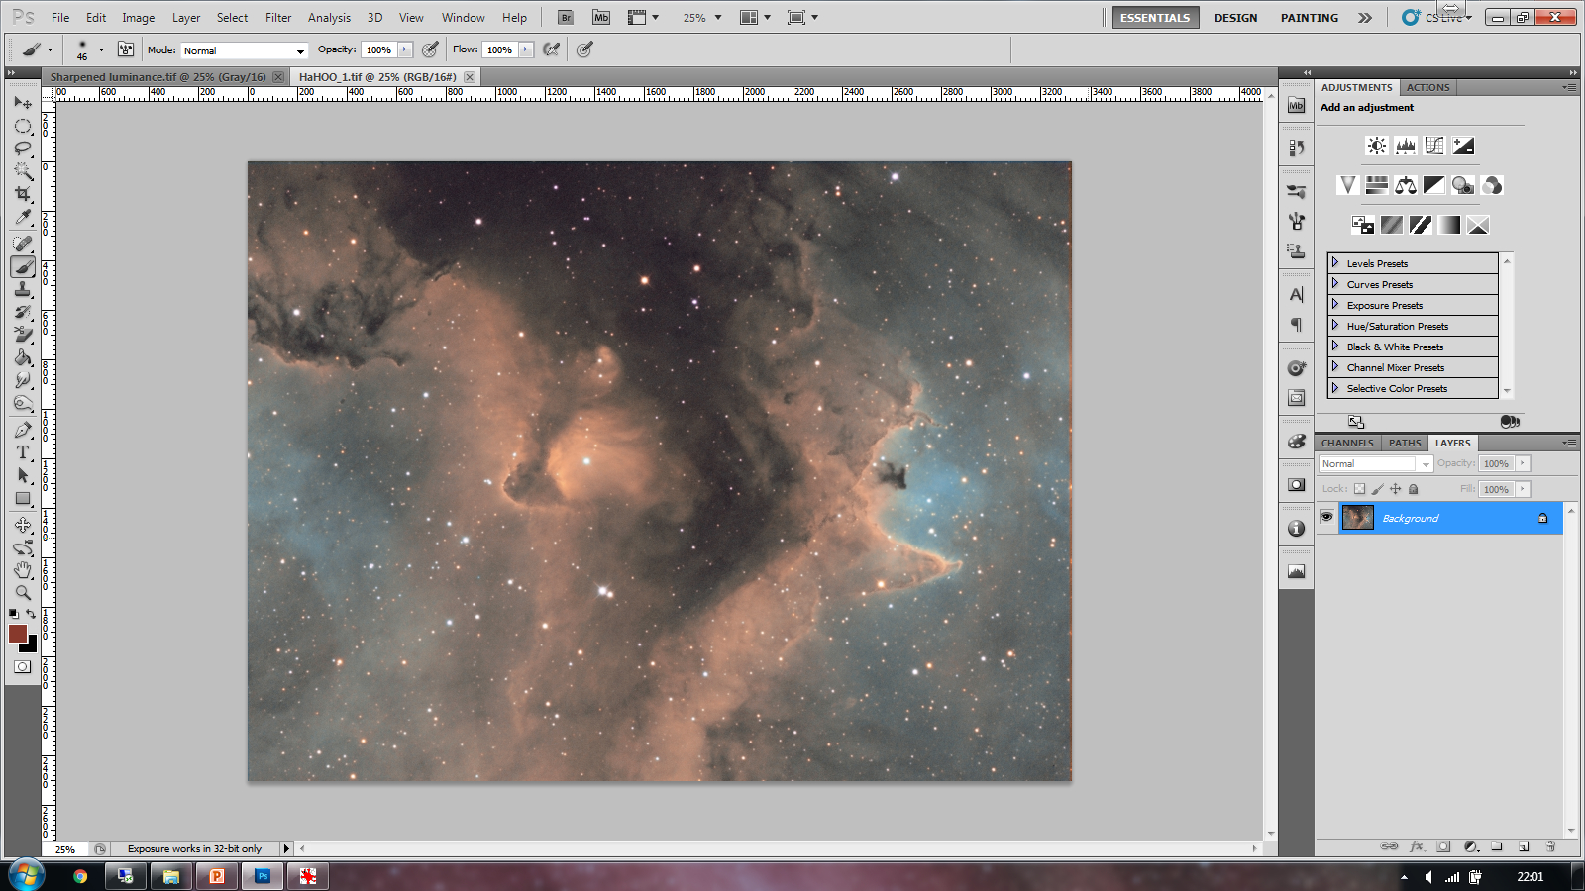
Processing
What is needed next ….

Slide 37
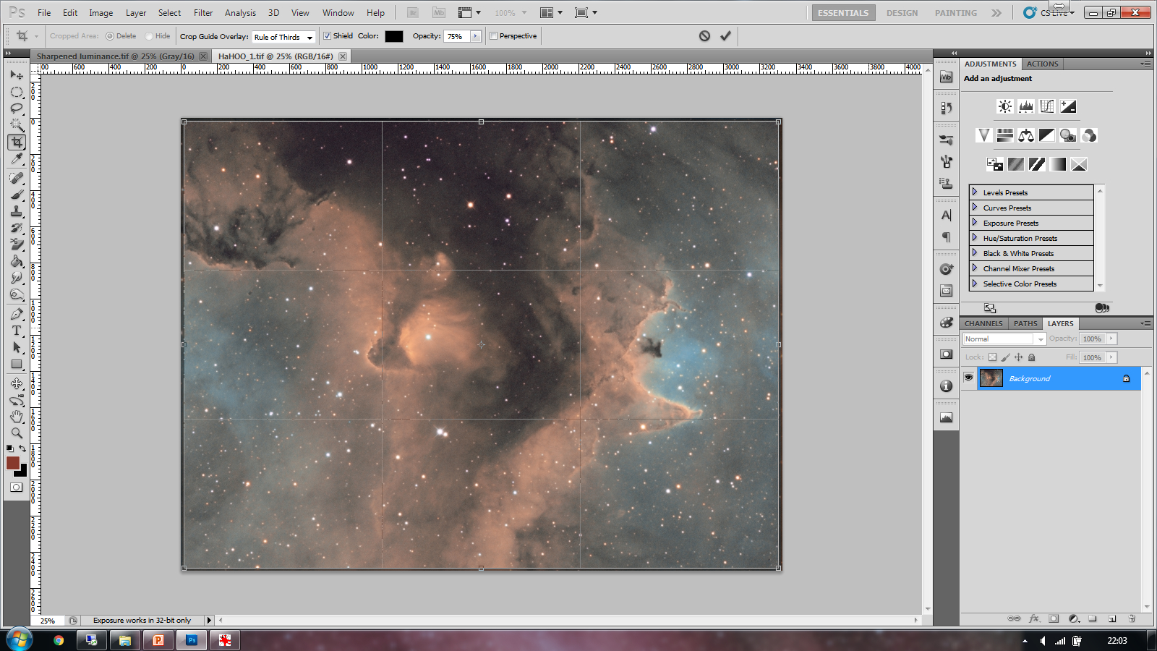
Processing
Crop the edges

Slide 38
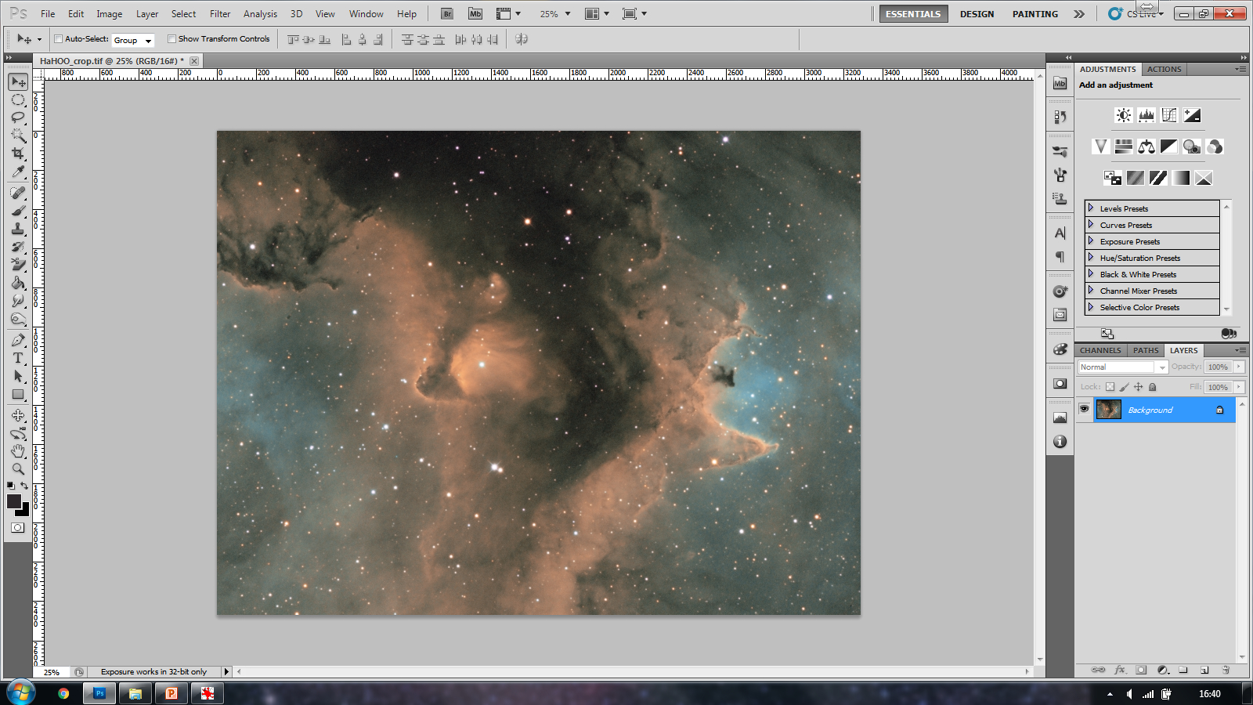
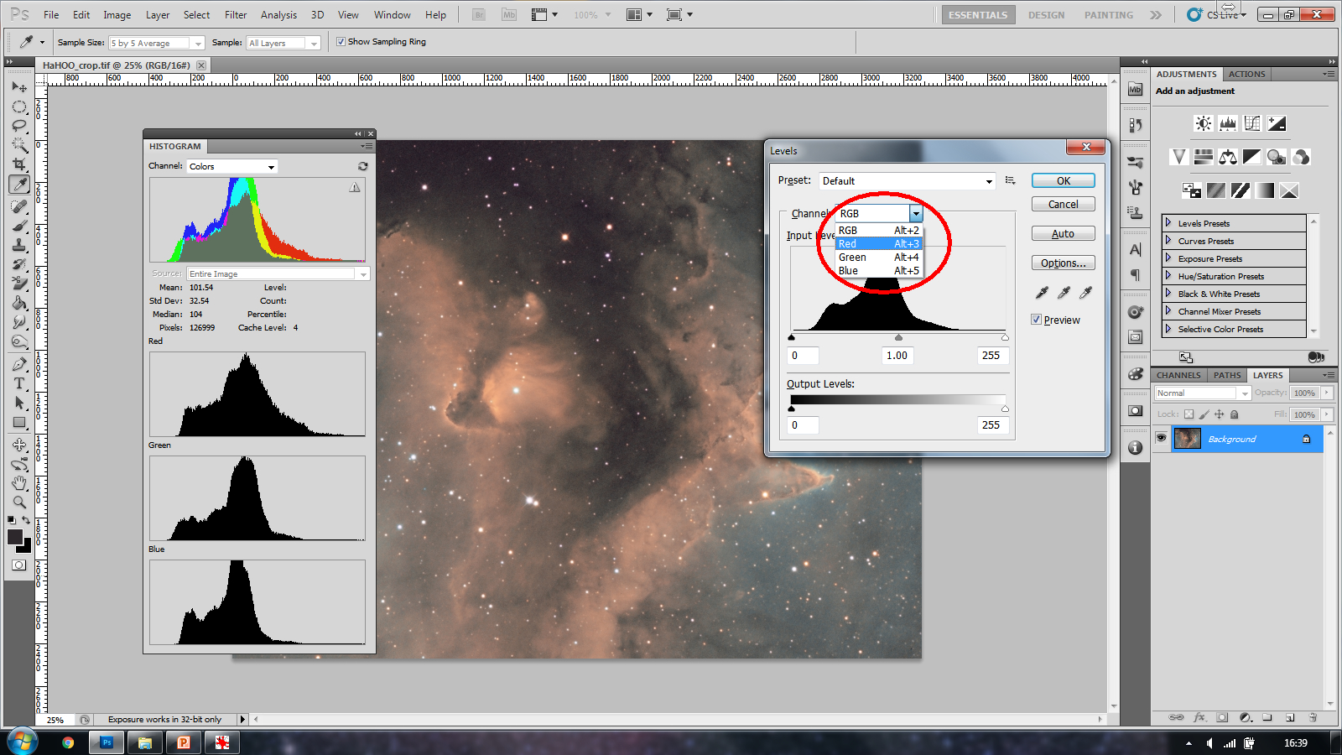
Processing
Move blackpoint on individual colours……. Attains a balanced histogram.
Check the levels and histogram

Slide 39
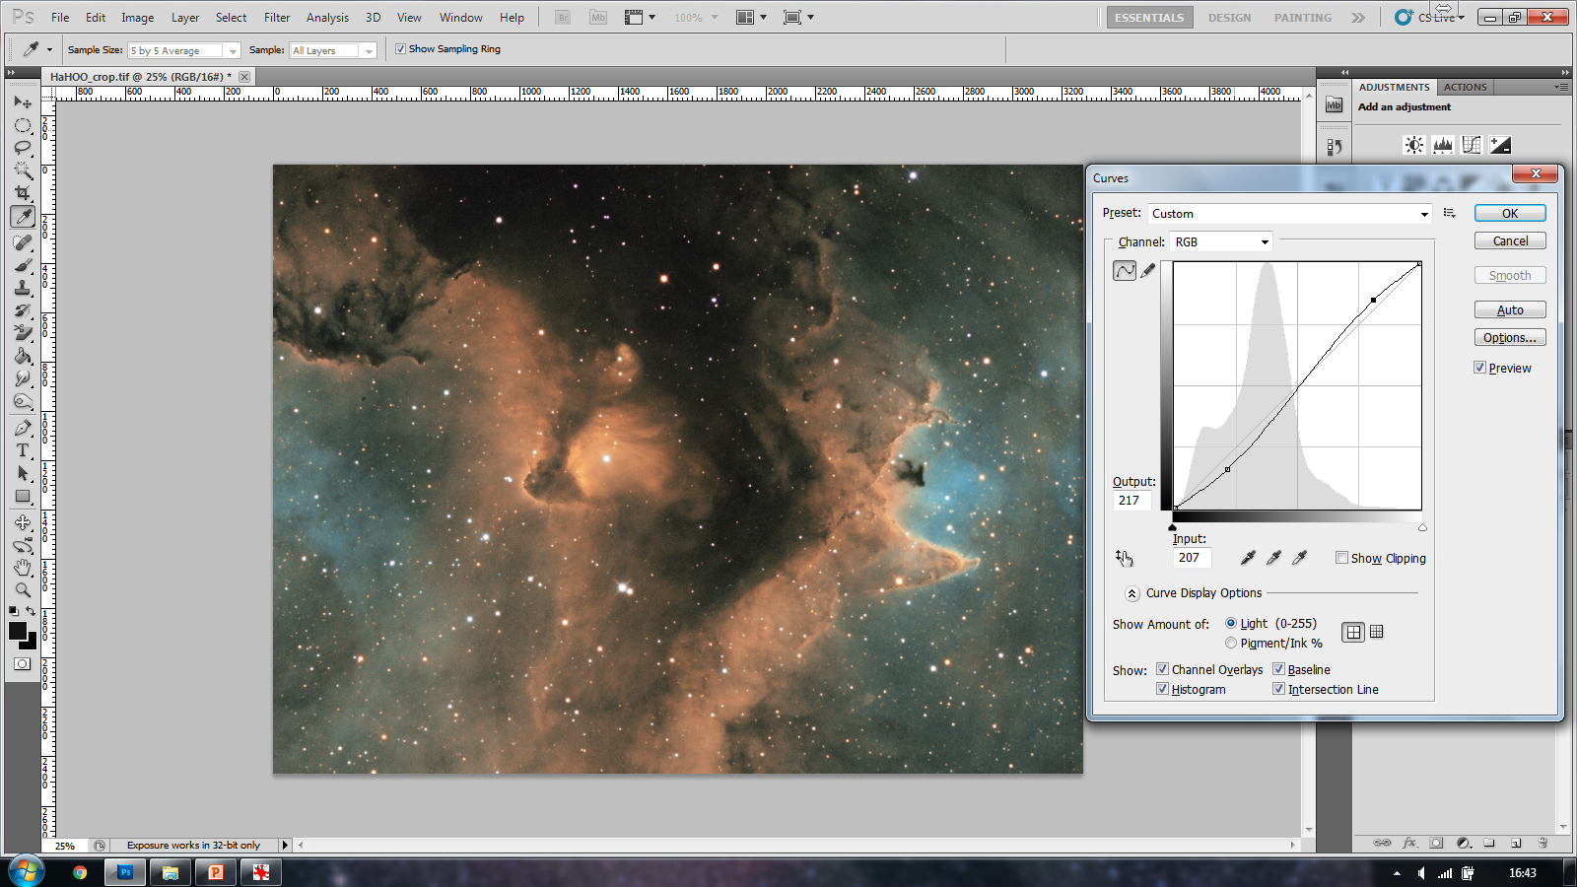
Processing
Contrast curve – Lowers the dark end and lightens the brighter areas…. Watch out for clipping
Contrast curve

Slide 40
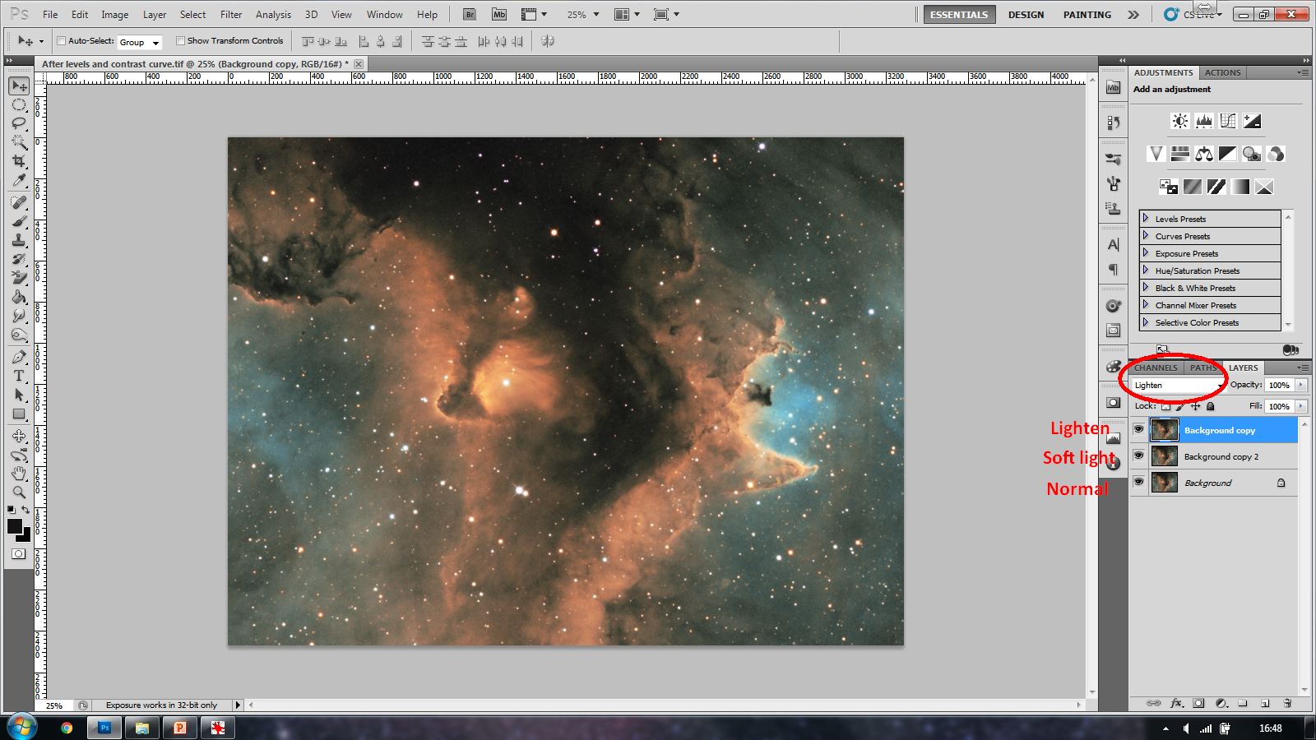
Processing
Create three duplicate layers.
Blend mode as shown
Flatten the complete image – Change opacity of the 2 upper layers to suit as required.
Create some punch

Slide 41
Processing
How to finally present your image

Slide 42
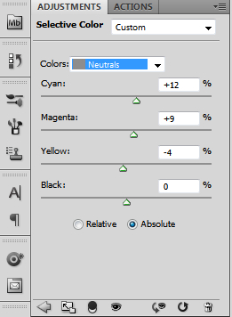
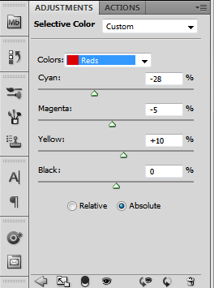
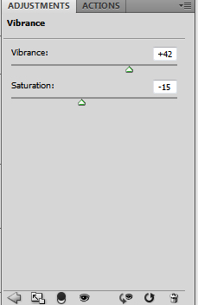
Processing
Selective colour

Slide 43
Processing
Rotate and flip the image according to taste

Slide 44
Processing
Let’s make things a little easier at the processing stage

Slide 45


Data Capture
Conditions
Moon
Light pollution
Wind
Seeing
Imagine how much a bright moon can wash out detail and stop you capturing the faint stuff
Your exposures times as well as overall detail will be affected
Filters can help with LP
Your mount needs to be rock solid when taking exposures – The wind can play havoc with this
Haze and humidity can affect your data by decreasing the seeing, affecting guiding and quality

Slide 46
Data Capture
Exposure length
Contrast
Noise
Ease of processing
4 hrs – 24x10mins 4 hrs – 8x30mins

Slide 47
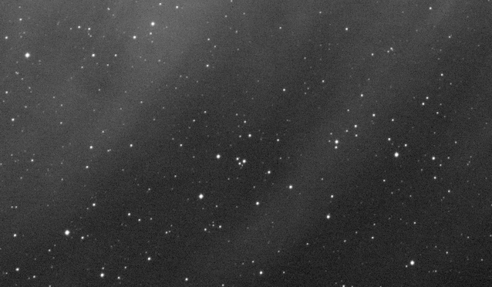


Data Capture
Noise
10min subs 1)
30min subs 2)
10min subs
30min subs

Slide 48

Data Capture
Focus
The V curve of automatic focus
A Bahtinov mask image
FWHM (Full width half minimum)

Slide 49


Data Capture
Focus
Out of focus
Bahtinov Grabber
Tells you when you are in critical focus
Manual focus and Bahtinov mask
In focus

Slide 50

Data Capture
Guiding
Off Axis guider or separate guide scope
What are we aiming for
An overall guiding figure (RMS) of less than either
The seeing
The image resolution of the imaging scope

Slide 51
Data Capture
Checking exposure integrity
Why
When
How
To ensure that each exposure is
Well focused
Well guided
If a mosaic – That they fit together
At the end of every session then you can add extra exposures into your run if needed
Data capture software (image checking)
Pixinsight (blink) or sub frame selector script

Slide 52



Processing
Calibration
Bias
Flat
Dark

Slide 53

Thank you
Sara Wager

